Slide 1


Titolo presentazione sottotitolo
Software Engineering for Automation
Iqueue Project
Andrea Gottardini, Gianluca Giacomelli, Niccolò Enrico Veronese
Milano, XX mese 20XX

Slide 2
Content
𝙸𝚚𝚞𝚎𝚞𝚎
1. Feasibility study
2. Requirement analysis
3. Design analysis
4. Implementation
5. Testing
UML requirements
UML architectural
Giacomelli, Gottardini, Veronese

Slide 3


Feasibility study
𝙸𝚚𝚞𝚎𝚞𝚎
𝙸𝚚𝚞𝚎𝚞𝚎
Giacomelli, Gottardini, Veronese

Slide 4
Content
𝙸𝚚𝚞𝚎𝚞𝚎
1. Feasibility study
2. Requirement analysis
3. Design analysis
4. Implementation
5. Testing
UML requirements
UML architectural
Giacomelli, Gottardini, Veronese

Slide 5





Feasibility study
𝙸𝚚𝚞𝚎𝚞𝚎
Feasibility Study helps to objectively decide whether to proceed with a proposed project or not.
Description of Application Function and Goals
Technology Considerations
Product Service Marketplace
Customers can see the queue
Shop owners can advertise the shops
QR code based
Pyhton Django
QR code reading
GPS system
The global queue management systems in terms of revenue was $0.5 billion in 2020
PostCovid Growth
Giacomelli, Gottardini, Veronese

Slide 6

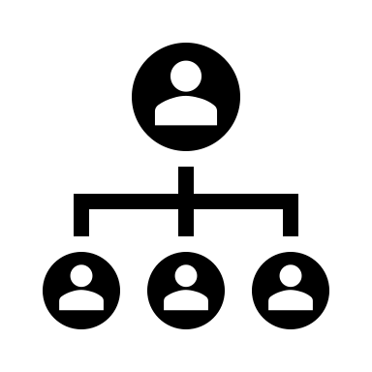
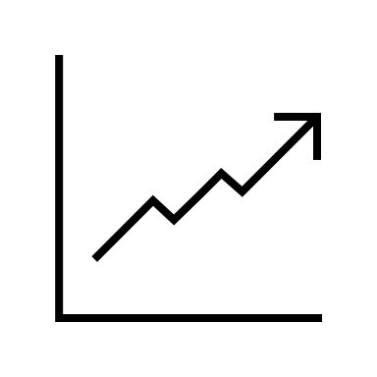
Feasibility study
𝙸𝚚𝚞𝚎𝚞𝚎
Marketing Strategy
Organization and Staffing
Financial Projections
Focus on small/medium companies
Gain for both Customer and Shop owners
Social media campaign
App development manager
Sales and Marketing Manager
Customer Support Representative
In-app purchases
In-app advertising
Freemium
Giacomelli, Gottardini, Veronese

Slide 7
Requirement analysis
𝙸𝚚𝚞𝚎𝚞𝚎
𝙸𝚚𝚞𝚎𝚞𝚎
Giacomelli, Gottardini, Veronese

Slide 8
Content
𝙸𝚚𝚞𝚎𝚞𝚎
1. Feasibility study
2. Requirement analysis
3. Design analysis
4. Implementation
5. Testing
UML requirements
UML architectural
Giacomelli, Gottardini, Veronese

Slide 9
Requirements Analysis (RASD)
𝙸𝚚𝚞𝚎𝚞𝚎
A RASD is a document that aims to present all the requirements of the system to be developed, explaining the domain in which it has to operate and what the application will do in a detailed way.
Goal
Product functions
Elicitation of requirements
Specific requirements
Giacomelli, Gottardini, Veronese

Slide 10
Requirements Analysis (RASD) - Goal
𝙸𝚚𝚞𝚎𝚞𝚎
Goal
Customer
View the current queue status for the shop
Shop Owner
Better forecast and plan their inventory and staffing needs based on the expected footfall of customers
Book time slots
Get discounts or other benefits by using the Iqueue app
Provide feedback and ratings for the shops
Search and discover new shops based on their preferences and location
Improve the brand awareness and visibility
Offer personalized promotions
Build customer loyalty
Access analytics and insights on their business performance
Giacomelli, Gottardini, Veronese

Slide 11



Requirements Analysis (RASD) – Product Function
𝙸𝚚𝚞𝚎𝚞𝚎
Product Function
Data collection
Customer information (name, email, birthday, password, location,..)
Data analysis
Associate the booking with the time slot and the queue
Shop Owner information (shop, product, advertisement, special offers)
Inc/dec system
Associate the Inc/dec system with the queue
Associate the Shop Owner info to the correspoding Shop
QR code reading and generating
GPS system connection
Giacomelli, Gottardini, Veronese

Slide 12
Requirements Analysis (RASD) – Elicitation of requirements
𝙸𝚚𝚞𝚎𝚞𝚎
Elicitation of requirements
Stakeholders
People with a smartphone willing to go in a Shop
Existing systems
Qminder: high price, big companies, supermarkets
People who own a small/medium Shop
GPS systems
Waitwhile: low price, no Map/GPS interface
Qwaiting: QR code based, high price
People must know how to use a smartphone (download an App) and how to scan a QR code
Giacomelli, Gottardini, Veronese

Slide 13
Requirements Analysis (RASD) – Elicitation of requirements
𝙸𝚚𝚞𝚎𝚞𝚎
Elicitation of requirements
Scenarios: a narrative description of what people do and experience as they try to make use of computer systems and applications. From the scenarios general Use cases can be derived and they are analysed considering the following features:
Actors: Iqueue, Client, Shop Owner, GPS system
Entry Condition
Flow of Events
Exit Condition
Exceptions
Special Requirements
Scenarios
Difficulties in finding the pastries for the party
Difficulties in counting the visitors
Poor number of clients
New in town
Giacomelli, Gottardini, Veronese

Slide 14
Requirements Analysis (RASD) – From scenarios to use cases
𝙸𝚚𝚞𝚎𝚞𝚎
Scenario
Actors
Client, Shop Owner, Iqueue, GPS system
Entry Condition
A long queue outside a shop
Flow of Events
The Client selects a certain type of shops (bakeries in the scenario).
Iqueue show on his map a list of the available shops of the indicated type with their queues.
The Client selects a shop.
Iqueue shows the available products, time slots and special offers.
The Client scans the products and select a free time slot.
Iqueue notifies the Shop Owner of the time slot booking.
The Client chooses to be guided to the shop.
Iqueue redirects the Client to a third-party GPS system and provides to it the shop address.
Exit Condition
The Client is guided by the GPS system. The selected time slot is now unavailable to any other Client. The client receives the QR code with the booked time slot.
Special Requirements
The queue of a shop has not to exceed in time the opening hours of the shop, otherwise the time slot is unavailable. The Client must have a GPS system on his device
Difficulties in finding the pastries for the party
Use Case
Book
Giacomelli, Gottardini, Veronese

Slide 15
Requirements Analysis (RASD) – From scenarios to use cases
𝙸𝚚𝚞𝚎𝚞𝚎
Scenario
Actors
Client, Shop Owner, Iqueue
Entry Condition
Client enters in a shop
Flow of Events
Shop Owner asks the Client if he has done a reservation with Iqueue.
Exit Condition
The use case terminates after the increment of the client counter. Shop Owner can consult the client counter value on different shop opening accessing Iqueue.
Exceptions
If the Client has not done his registration on Iqueue, the Shop Owner increments the client counter on Iqueue by himself with the inc/dec system.
The Shop Owner scans the client QR code.
Iqueue increments the counter client for the shop of the relative shop opening.
Difficulties in counting the visitors
Use Case
Count clients
Giacomelli, Gottardini, Veronese

Slide 16
Requirements Analysis (RASD) – From scenarios to use cases
𝙸𝚚𝚞𝚎𝚞𝚎
Scenario
Actors
Shop Owner, Iqueue
Entry Condition
Shop Owner has a shop
Flow of Events
Shop Owner starts register Shop procedure on Iqueue.
Exit Condition
The use case terminates after the product discounts entering. Shop registration is now terminated, and the shop is now visible on the Iqueue map with its products.
Exceptions
The insertion of shop position and products is mandatory to conclude the shop registration on Iqueue; The Shop Owner could not insert immediately pictures, the logo of his shop and the special offers on products to register his shop. They could be inserted in a second moment.
Iqueue asks shop position to the Shop Owner.
Shop Owner inserts the shop position.
Iqueue asks shop logo and/or pictures to the Shop Owner.
Shop Owner inserts the shop logo and/or pictures (optional).
Iqueue asks Shop Owner to insert products of his shop.
Shop Owner inserts the products.
Iqueue asks Shop Owner to insert special offers on products.
Shop Owner inserts the special offers on products (optional).
Poor number of clients
Use Case
Register shop
Giacomelli, Gottardini, Veronese

Slide 17
Requirements Analysis (RASD) – From scenarios to use cases
𝙸𝚚𝚞𝚎𝚞𝚎
Scenario
Actors
Client, Iqueue
Entry Condition
Client likes to know shops in his surroundings
Flow of Events
Client allows Iqueue to know his position.
Exit Condition
The use case terminates after the Iqueue shows the products and special offers. Client could now book a time slot or simply exit the application.
Special Requirements
The Client must have a device which is able to provide the position to the Iqueue.
Client selects a certain type of shops.
Iqueue show on his map a list of the available shops of the indicated type with their queues.
Client selects a maximum distance from the shops.
Iqueue shows the shops accordingly with the selected distance.
The Client selects a shop.
Iqueue shows the available products and special offers.
New in town
Use Case
Search
Giacomelli, Gottardini, Veronese

Slide 18
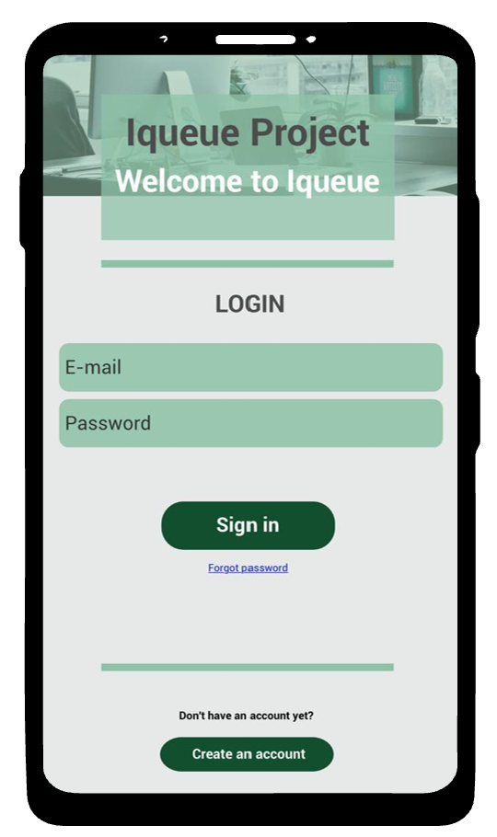
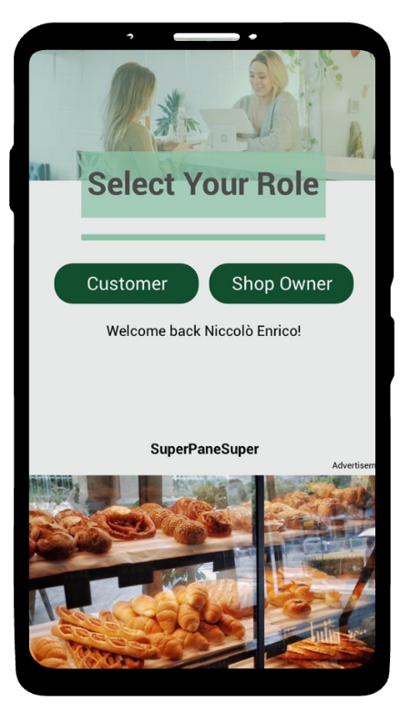
Requirements Analysis (RASD) – Specific requirements
𝙸𝚚𝚞𝚎𝚞𝚎
Specific requirements
External interfaces – User interfaces
1. Initial page of the system
2. Select your role page
Giacomelli, Gottardini, Veronese

Slide 19
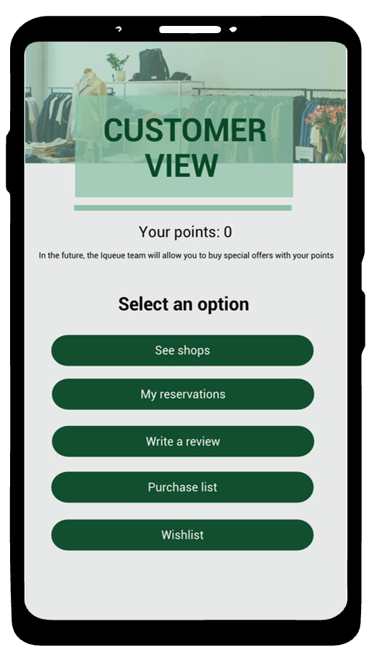
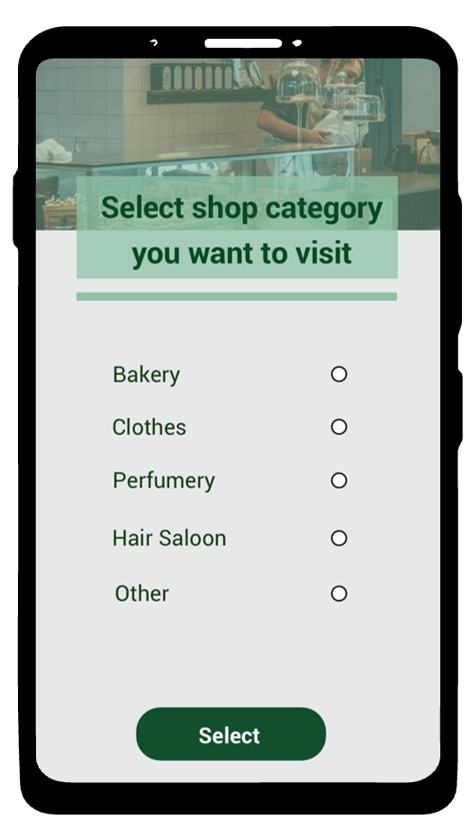
Requirements Analysis (RASD) – Specific requirements
𝙸𝚚𝚞𝚎𝚞𝚎
Specific requirements
External interfaces – Customer interfaces
1. Customer view
2: Select shop category view
Giacomelli, Gottardini, Veronese

Slide 20
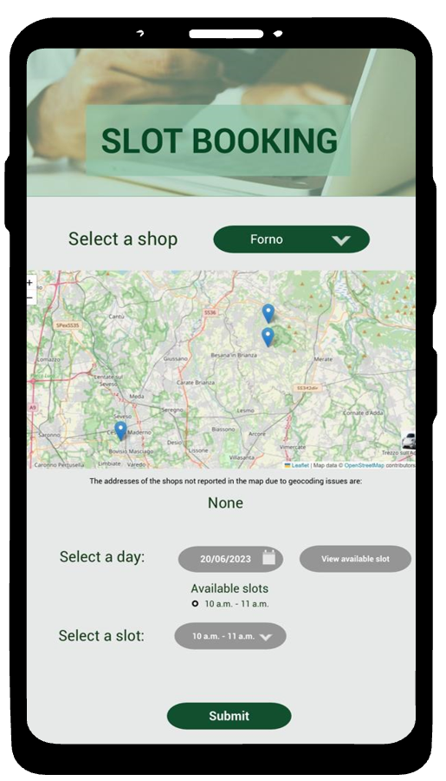
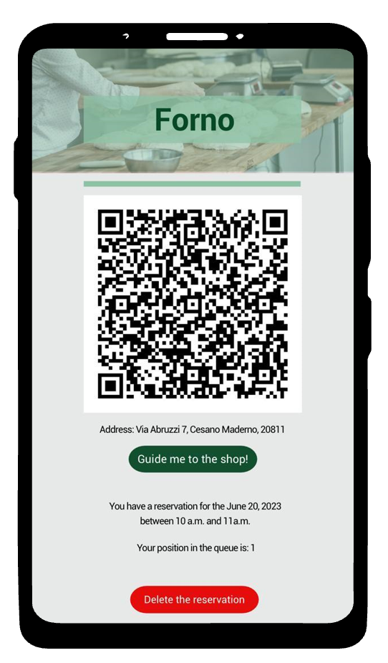
Requirements Analysis (RASD) – Specific requirements
𝙸𝚚𝚞𝚎𝚞𝚎
Specific requirements
External interfaces – Customer interfaces
3. Slot booking view
4: My reservation view
Giacomelli, Gottardini, Veronese

Slide 21
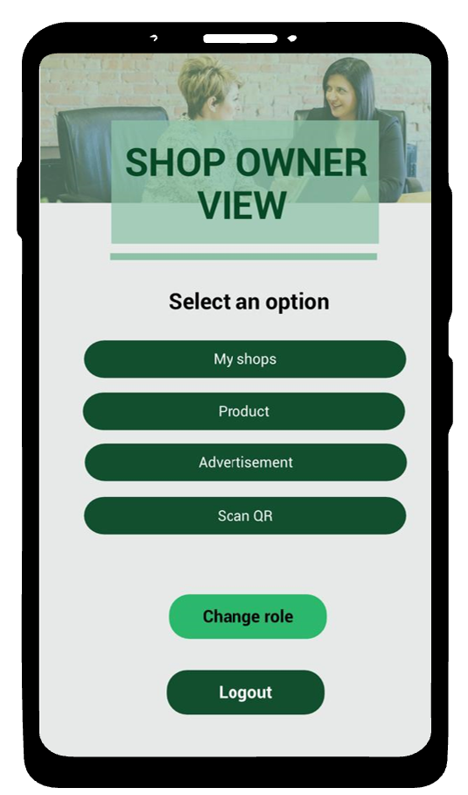
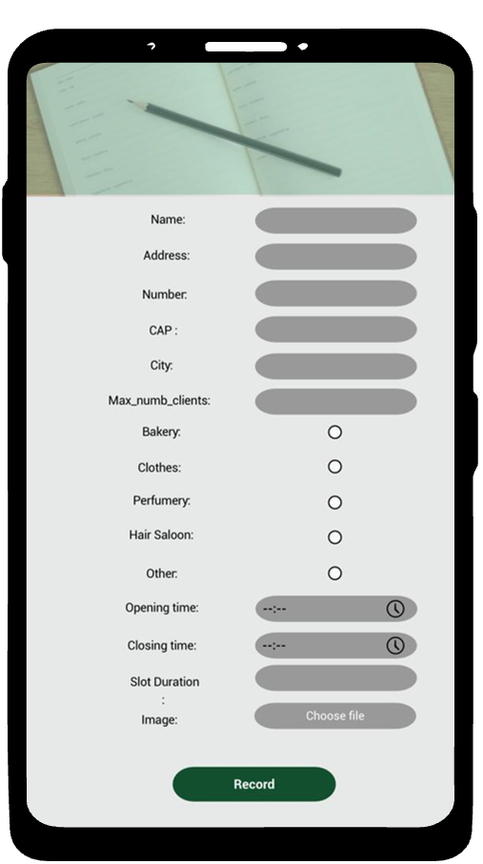
Requirements Analysis (RASD) – Specific requirements
𝙸𝚚𝚞𝚎𝚞𝚎
Specific requirements
External interfaces – Shop owner interfaces
1. Shop owner view
2. Register Shop page
Giacomelli, Gottardini, Veronese

Slide 22
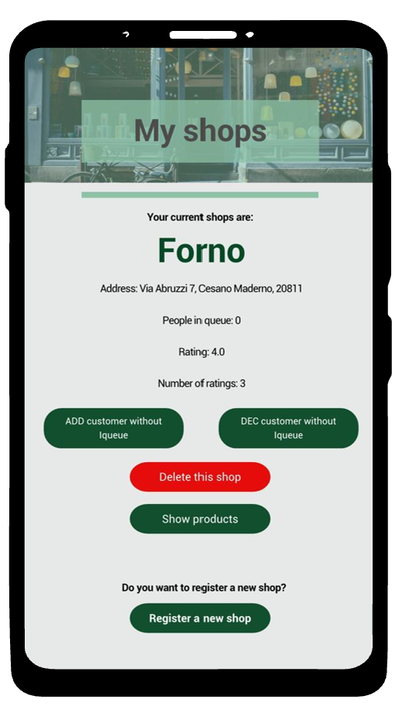
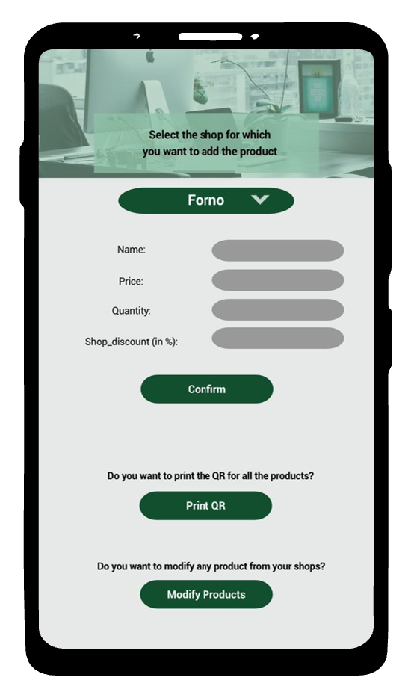
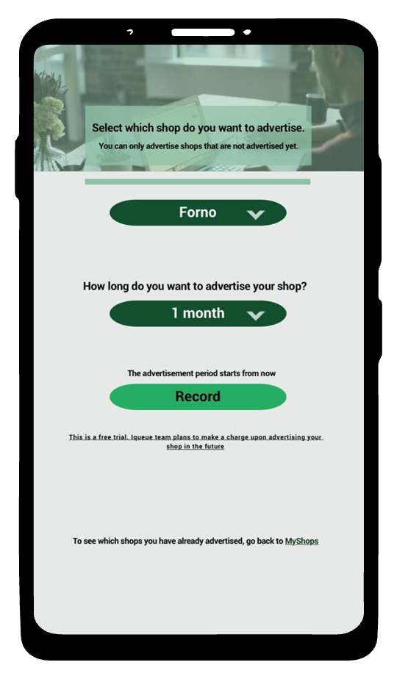
Requirements Analysis (RASD) – Specific requirements
𝙸𝚚𝚞𝚎𝚞𝚎
Specific requirements
External interfaces – Shop owner interfaces
3. My Shops view
4. Register product page
5. Register advertisement page
Giacomelli, Gottardini, Veronese

Slide 23
Requirements Analysis (RASD) – Specific requirements
𝙸𝚚𝚞𝚎𝚞𝚎
Specific requirements
 | REQUIREMENTS
R1 | Iqueue must allow the customers to see the number of people in the queue at a specific shop
R2 | Iqueue shall allow the shop owners to insert the data of their activity
R3 | Iqueue shall allow the shop owners to insert special offers for their shop
R4 | Iqueue must read the QR code of the clients with the app
R5 | The app shall allow customers to track their rewards
R6 | Iqueue must allow a customer to book a time slot on the app to visit the shop
R7 | Iqueue must keep track of the customer position
R8 | Iqueue allow the shop owner to associate a mean time for every person in the queue.
R9 | Iqueue calculates the waiting time of a customer, based on the mean time for every person in the queue.
R10 | The app shall allow customers to create and save shopping lists or wish lists.
Giacomelli, Gottardini, Veronese

Slide 24
Requirements Analysis (RASD) – Specific requirements
𝙸𝚚𝚞𝚎𝚞𝚎
Specific requirements
 | REQUIREMENTS
R11 | The app shall show the customer's purchase history and receipts
R12 | The app will be able to divide the registered facilities into categories
R13 | The app will permit the shop owner to insert their products/services
R14 | The app will enable shop owners to insert the price of their products/services
R15 | The app will enable shop owners to modify the price of their products/services
R16 | Iqueue must be able to generate the client QR code
R17 | Iqueue must show the available time slots of a shop
R18 | Iqueue must permit a customer to delete his booked time slot
R19 | The app will show the registered shops on a map/list
R20 | Iqueue shall allow the shop owners to modify the data of their activity
Giacomelli, Gottardini, Veronese

Slide 25
Requirements Analysis (RASD) – Specific requirements
𝙸𝚚𝚞𝚎𝚞𝚎
Specific requirements
 | REQUIREMENTS
R21 | Iqueue shall permit the shop owners to delete the data of their activity
R22 | Iqueue shall allow the shop owners to modify special offers for their shop
R23 | Iqueue shall allow the shop owners to delete special offers for their shop
R24 | The app must be able to track customer rewards and loyalty points
R25 | Iqueue must allow user registration
R26 | Iqueue must allow the user to operate as customer or as shop owner
R27 | Iqueue must allow log-in as customer
R28 | Iqueue must allow log-in as shop owner
R29 | Iqueue must allow log-out
R30 | The app will enable shop owners to remove their products/services
Giacomelli, Gottardini, Veronese

Slide 26
Requirements Analysis (RASD) – Specific requirements
Specific requirements
 | REQUIREMENTS
R31 | The app will enable shop owners to count their available products/services
R32 | Iqueue will be able to realize to queue counting by means of the QR codes
R33 | Iqueue will allow the shop owner to manually increment or decrement the queue counter
R34 | Iqueue shall allow the customer to select the category of the shops he is interested to visit
R35 | Iqueue shall allow the customer to select a specific shop
R36 | Iqueue shall allow the customer to select a specific shop product/service
R37 | Iqueue establishes counters to keep track of the client visits during the shops opening hours.
R38 | The app shall allow the shop owner to advertise their shop
R39 | The app shows the user of the interested queue variation
R40 | Iqueue shall give the shop address to a third-party GPS system to guide the client to the shop
R41 | Iqueue will allow the client to provide feedback and rating to the shops
Giacomelli, Gottardini, Veronese

Slide 27
Content
𝙸𝚚𝚞𝚎𝚞𝚎
Feasibility study
Requirement analysis
Design analysis
Implementation
Testing
UML requirements
UML architectural
Giacomelli, Gottardini, Veronese

Slide 28
UML requirements
𝙸𝚚𝚞𝚎𝚞𝚎
UML Requirements provides a detailed report of the UML class diagram of our Iqueue project. In this document a description of the main functionality of our app is present, together with an explanation of the classes, attributes, and methods of each component of it.
Classes
Methods
Sequence diagrams
Giacomelli, Gottardini, Veronese

Slide 29
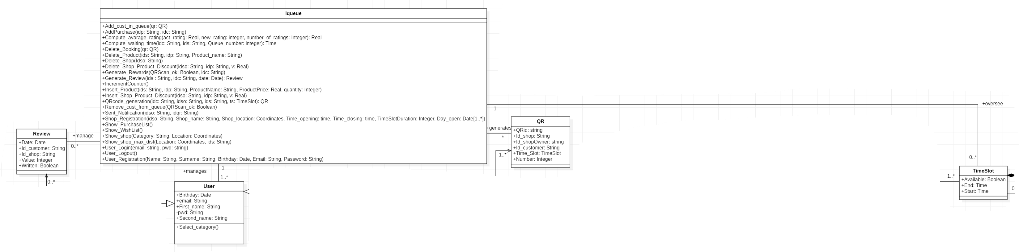
UML requirement - Classes
𝙸𝚚𝚞𝚎𝚞𝚎
Classes
Iqueue class: It has no attributes, but many methods which represent the operations which have to be performed by the WebApp. It is connected via association with the User class, with the TimeSlot class, with the QR code class and with the Review class.
Giacomelli, Gottardini, Veronese

Slide 30
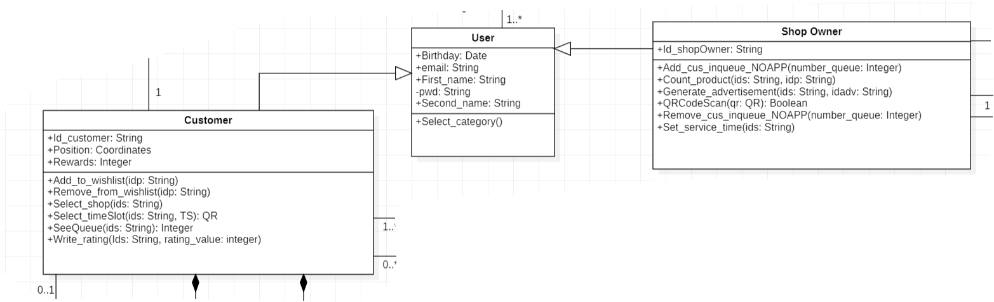
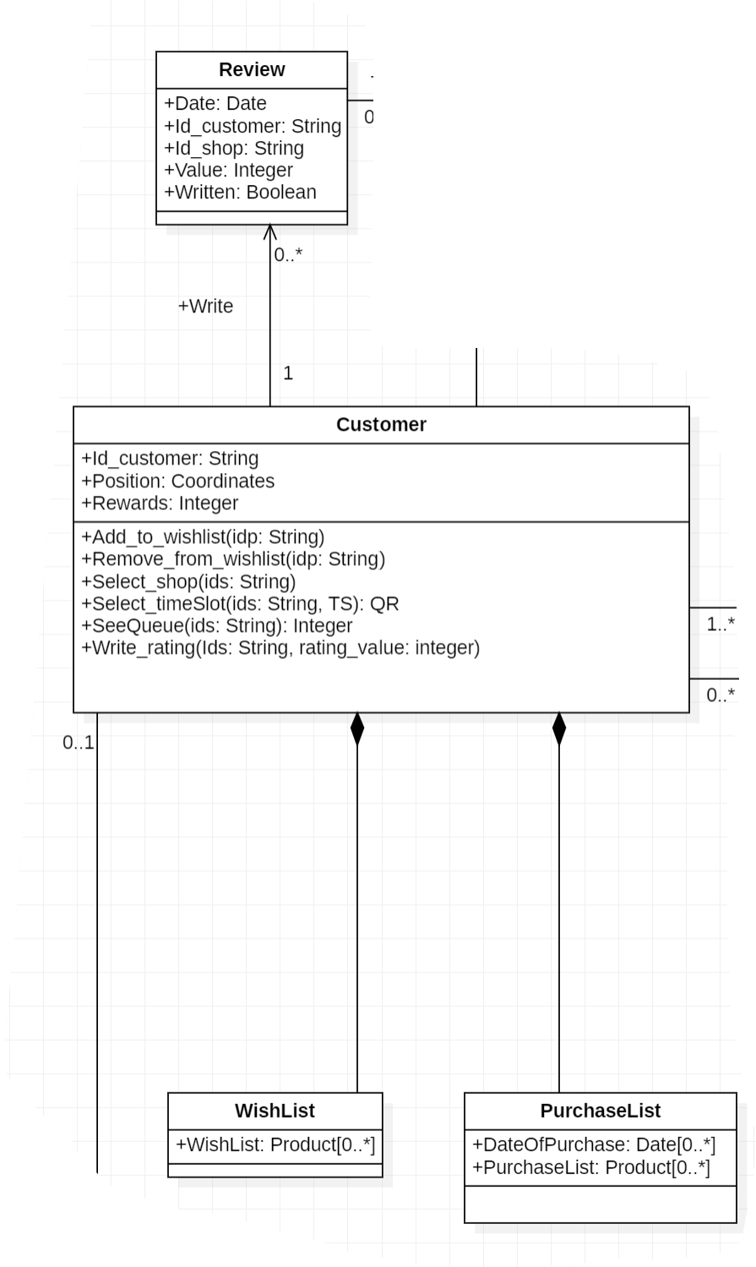
UML requirement - Classes
𝙸𝚚𝚞𝚎𝚞𝚎
User class:
User of the Iqueue app
Generalization of Customer and Shop owner
Customer class:
Attributes like position and rewards
It has compositions like Wishlist and Purchase list
Characterized by idc
Connected to TimeSlot class to generate the bookings and to the Review class
Review class:
Review genereted by Iqueue after customer QR is scanned
Giacomelli, Gottardini, Veronese

Slide 31
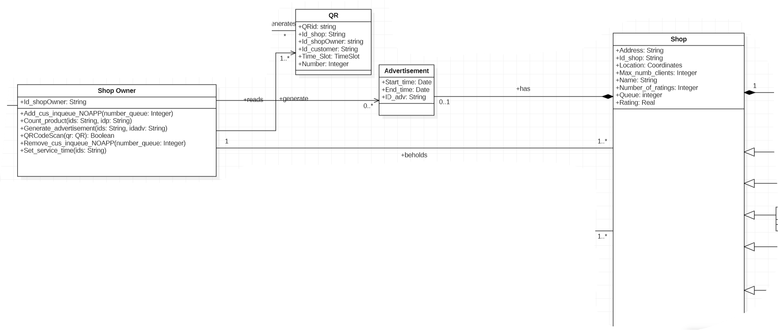
UML requirement - Classes
𝙸𝚚𝚞𝚎𝚞𝚎
QR class:
Connected to Shop Owner and Iqueue
Characterized QRid
Shop Owner class:
Characterized by idso
Advertisement class:
Characterized by idadv
It has a start and a finish date
Giacomelli, Gottardini, Veronese

Slide 32
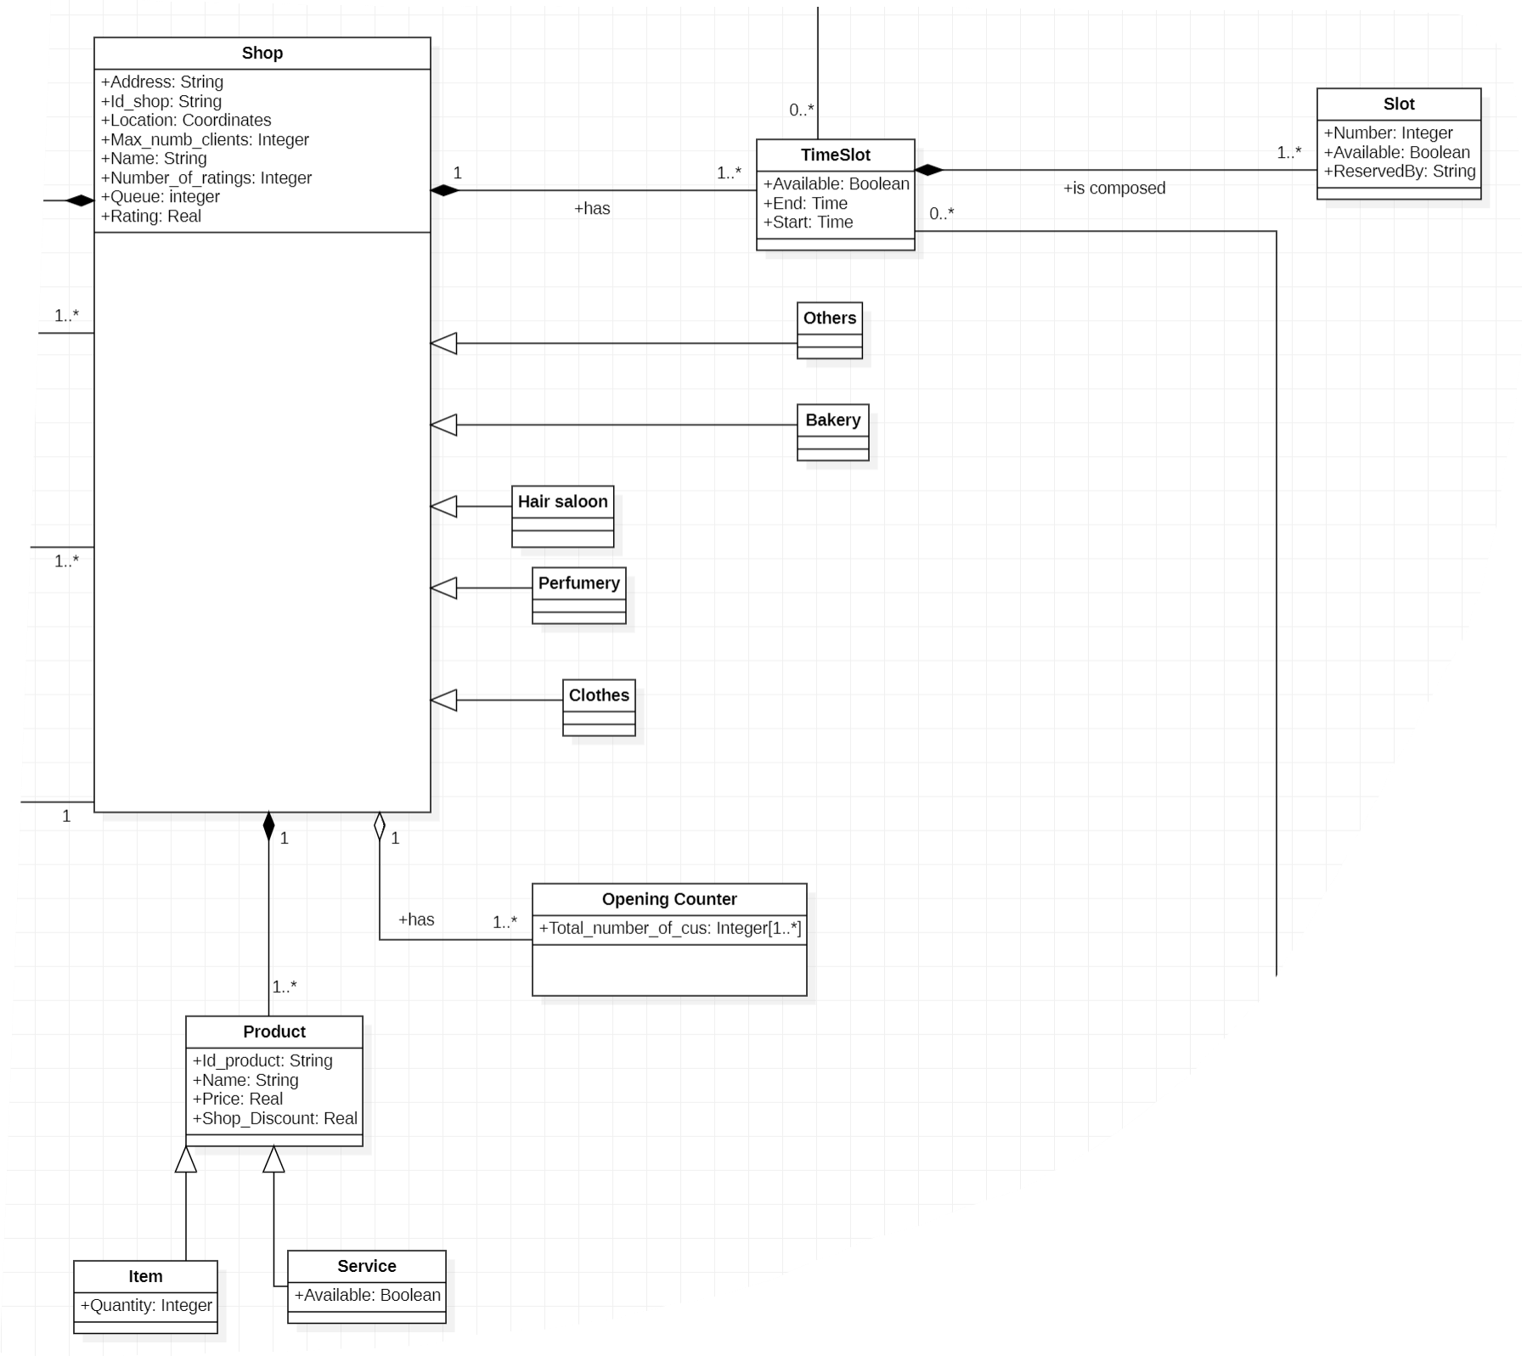
UML requirement - Classes
𝙸𝚚𝚞𝚎𝚞𝚎
Shop class:
Characterized by ids
Many attributes like address, location,
max_numb_clients, queue, rating, etc.
Product is its composition
It is a generalization of the different shop categories
Product class:
Composition of the Shop
Characterized by idp
Generalization of Item and Service
Time slot class:
Represents the mean with which the Customer can make his reservation in the Shop
Connected to Shop (each Shop has its own TimeSlot) and to Customer
Slot class:
Represents the available places in a Time Slot
The number of the slot indicates the position inside the queue in the Time Slot
Giacomelli, Gottardini, Veronese

Slide 33
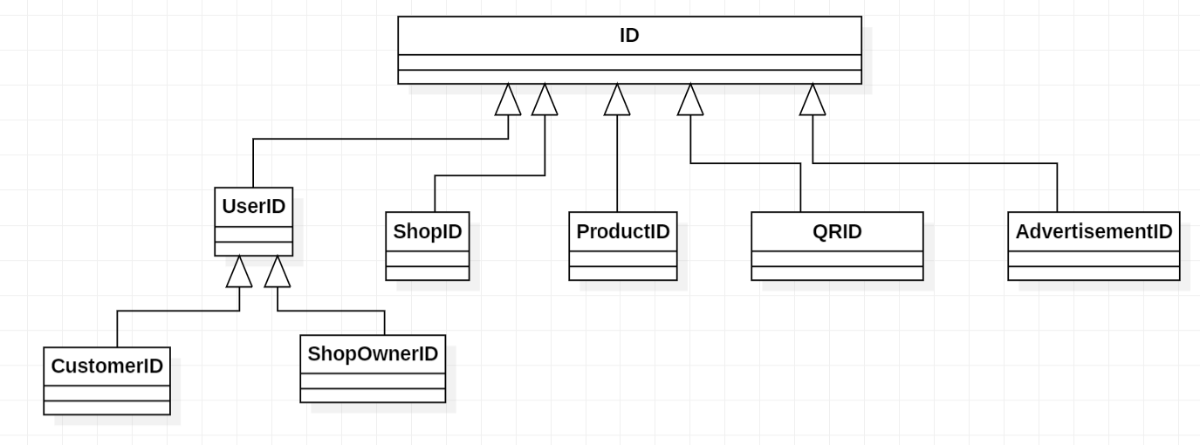
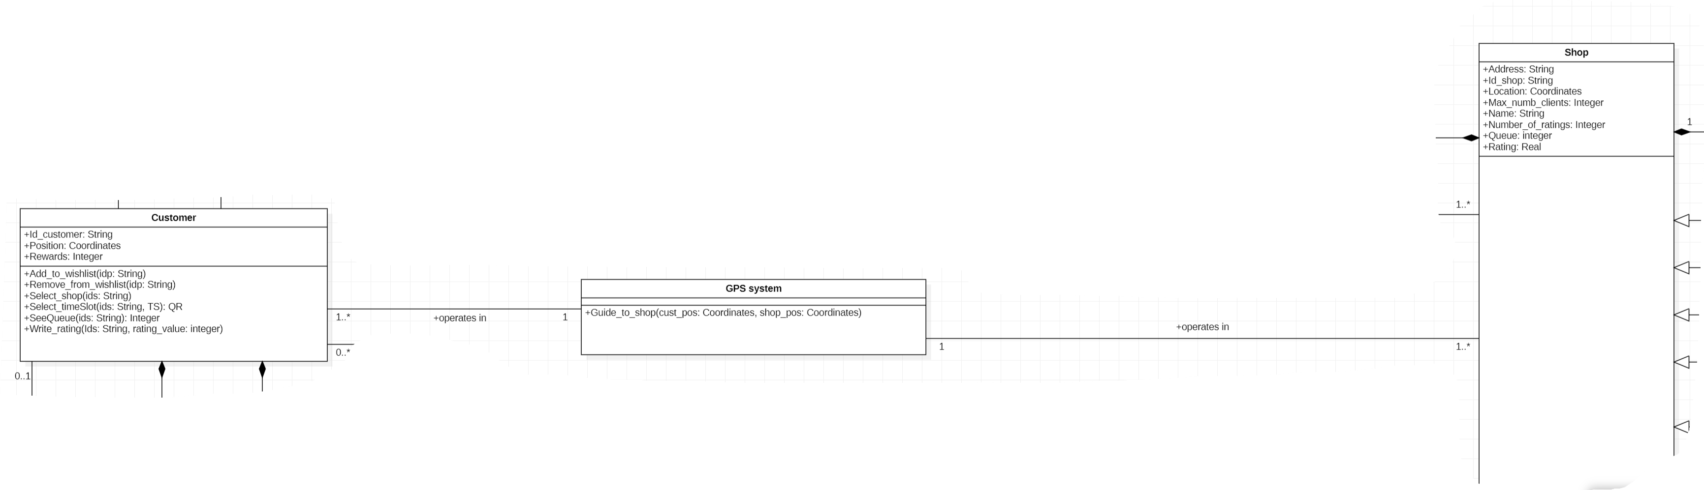
UML requirement - Classes
𝙸𝚚𝚞𝚎𝚞𝚎
ID class:
Useful to represent better the relationships among classes in the methods
GPS system class:
Connect the Customer with the Shop
Giacomelli, Gottardini, Veronese

Slide 34
UML requirement - Methods
𝙸𝚚𝚞𝚎𝚞𝚎
Methods
Iqueue Methods
User_registration(in Name:String, in Surname:String, in Birthday:Date, in Email:String, in Password:String)
Insert_Product(in ids:String, in idp:String, in ProductName:String, in ProductPrice:Real, in quantity:Integer)
User_login(in email:string, in pwd:string)
Shop_registration(in idso:String, in Shop_name:String, in Shop_location:Coordinates, in Time_opening:time, in Time_closing:time, in Day_open:Date[1..*])
QRcode_generation(in idc:String, in idso:String, in ids:String, in ts:TimeSlot): QR
Add_cust_in_queue(in qr:QR)
Show_shop(in Category:String, in Location:Coordinates)
Generate_rewards(in QRScan_ok:Boolean, in idc:String)
Compute_avarage_rating(in act_rating:Real, in new_rating:integer, in number_of_ratings:Integer): Real
Generate_Review(in ids :String, in idc:String, in date:Date): Review
Giacomelli, Gottardini, Veronese

Slide 35
UML requirement - Methods
𝙸𝚚𝚞𝚎𝚞𝚎
User Methods
Select_category()
Customer Methods
Select_shop(in ids:String)
Select_timeSlot(in ids:String, in TS:TimeSlot): QR
SeeQueue(in ids:String): Integer
Add_to_wishlist(in idp:String)
Remove_from_wishlist(in idp:String)
Write_rating(in Ids:String, in rating_value:integer)
Giacomelli, Gottardini, Veronese

Slide 36
UML requirement - Methods
𝙸𝚚𝚞𝚎𝚞𝚎
GPS System Method
Guide_to_shop(in cust_pos:Coordinates, in shop_pos:Coordinates)
Shop Owner Methods
QRCodeScan(in qr:QR): Boolean
Insert_product_discount(in idp:string, in v:Real): string
Add_cus_inqueue_NOAPP(in number_queue:Integer)
Remove_cus_inqueue_NOAPP(in number_queue:Integer)
Generate_advertisement(in ids:String, in idadv:String)
Giacomelli, Gottardini, Veronese

Slide 37
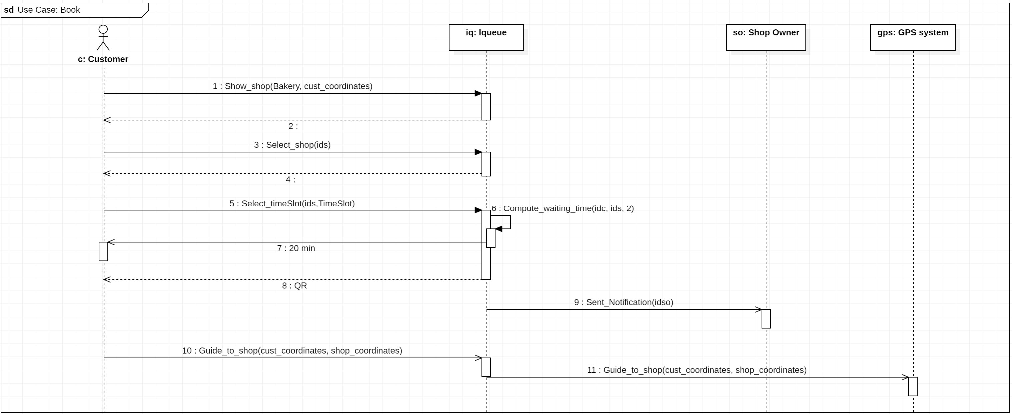
UML requirement – Sequence Diagrams
𝙸𝚚𝚞𝚎𝚞𝚎
Book Sequence Diagrams
Giacomelli, Gottardini, Veronese

Slide 38
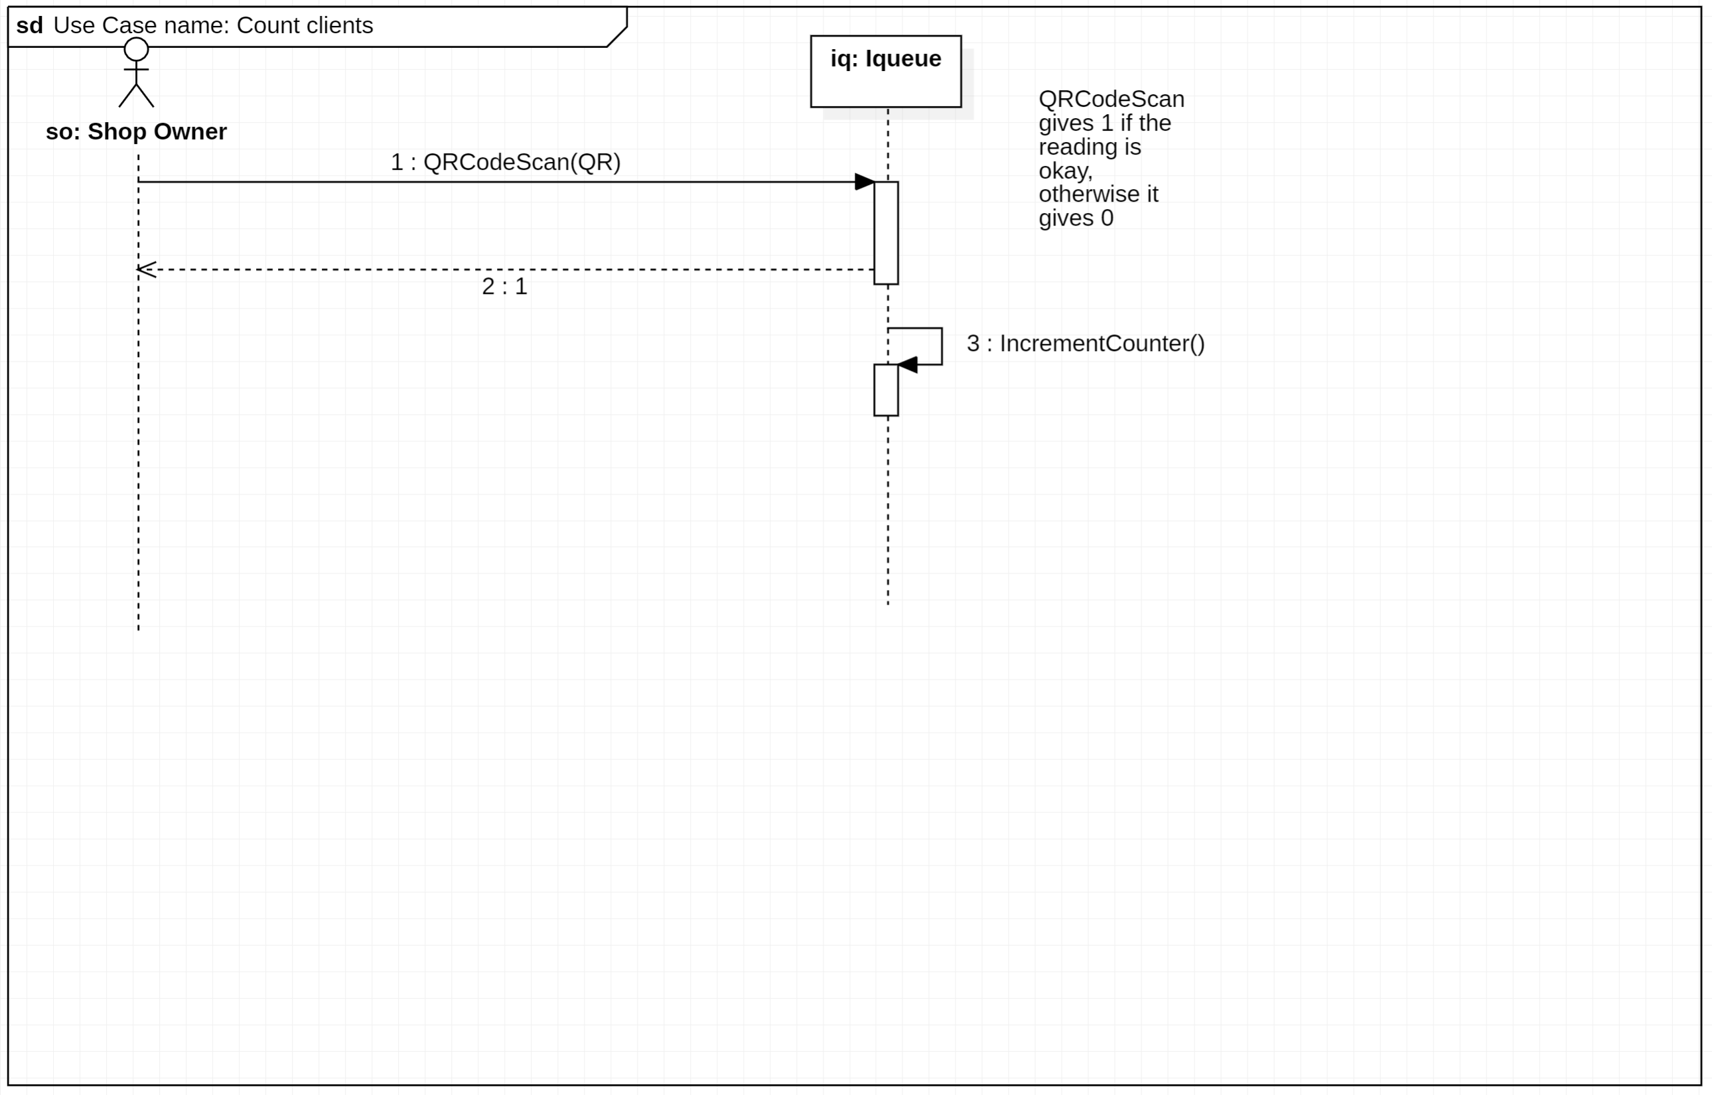
UML requirement – Sequence Diagrams
𝙸𝚚𝚞𝚎𝚞𝚎
Count client Sequence Diagrams
Giacomelli, Gottardini, Veronese

Slide 39
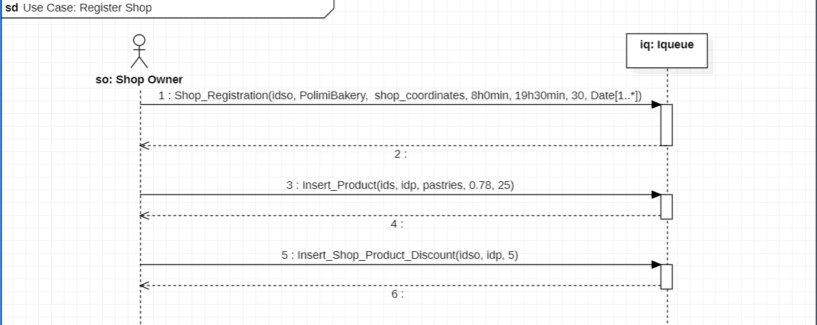
UML requirement – Sequence Diagrams
𝙸𝚚𝚞𝚎𝚞𝚎
Register shop - Sequence Diagrams
Giacomelli, Gottardini, Veronese

Slide 40
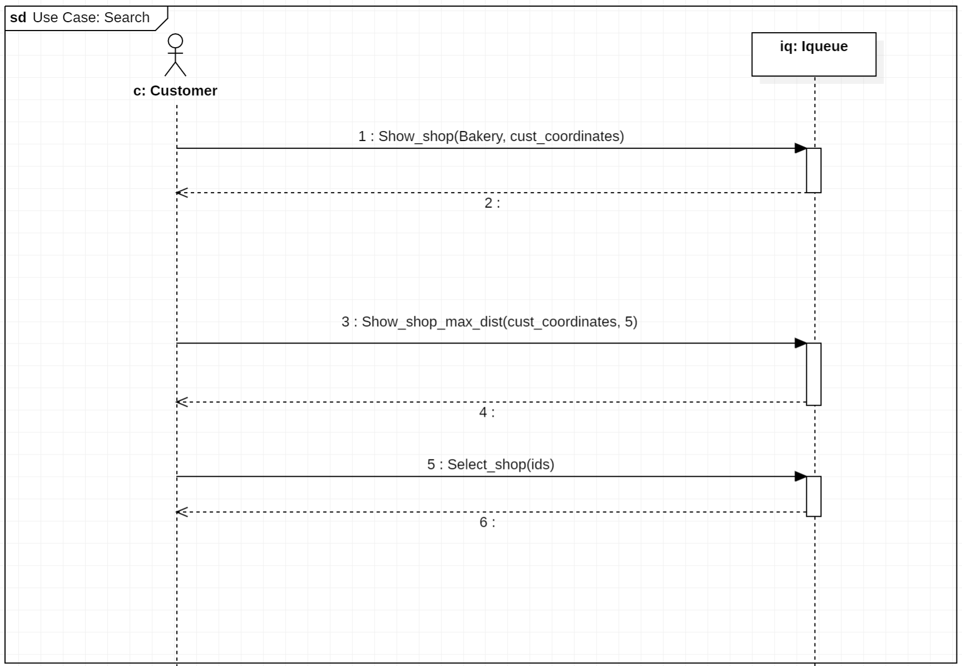
UML requirement – Sequence Diagrams
𝙸𝚚𝚞𝚎𝚞𝚎
Search - Sequence Diagrams
Giacomelli, Gottardini, Veronese

Slide 41
Design analysis
𝙸𝚚𝚞𝚎𝚞𝚎
𝙸𝚚𝚞𝚎𝚞𝚎
Giacomelli, Gottardini, Veronese

Slide 42
Content
𝙸𝚚𝚞𝚎𝚞𝚎
1. Feasibility study
2. Requirement analysis
3. Design analysis
4. Implementation
5. Testing
UML requirements
UML architectural
Giacomelli, Gottardini, Veronese

Slide 43
UML architectural
𝙸𝚚𝚞𝚎𝚞𝚎
The architectural UML has the goal of describing the relationships among the different actors in terms of the internal software components. This means that the Iqueue app will be divided into modules, each one with its own functionalities and which communicate with other components through interfaces.
Components
Interfaces
Sequence diagrams
Giacomelli, Gottardini, Veronese

Slide 44
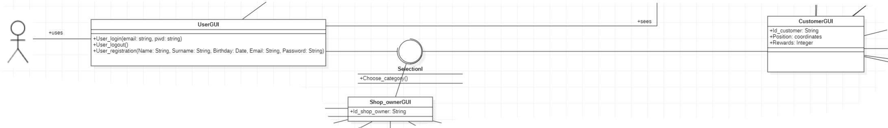
UML architectural - Components
𝙸𝚚𝚞𝚎𝚞𝚎
Components
UserGUI:
graphic interface for the User
methods User_login, User_logout and User_registration
Shop_OwnerGUI:
Connected to Shop Owner and Iqueue
Characterized Idso
CustomerGUI:
graphic interface for the customer
Characterized by idc, position, rewards
Giacomelli, Gottardini, Veronese

Slide 45
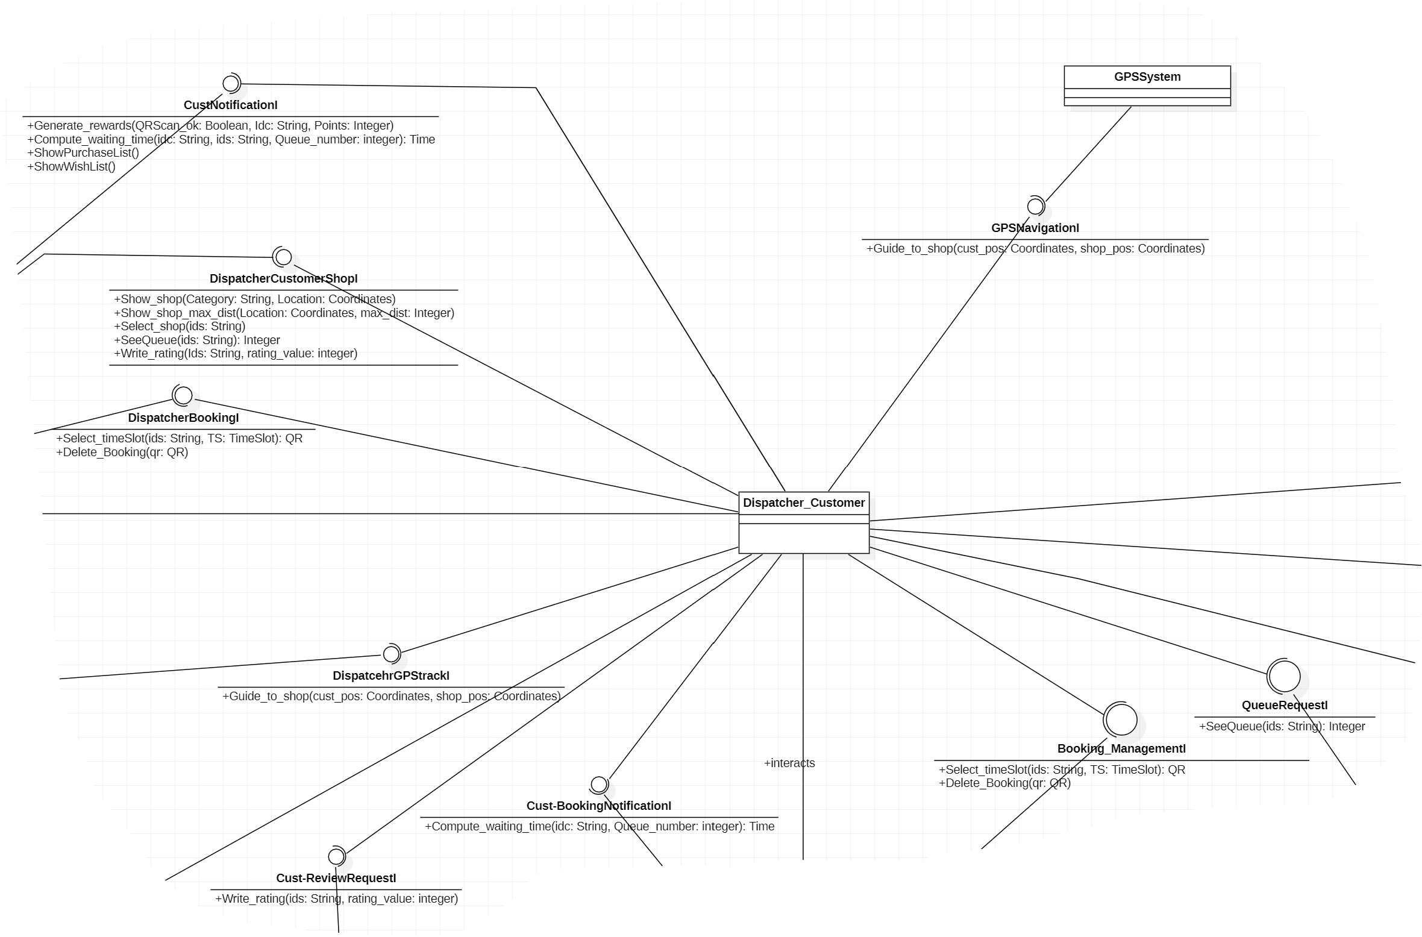
UML architectural - Components
𝙸𝚚𝚞𝚎𝚞𝚎
Components
Dispatcher_Customer:
It is specific for the Customer requests.
It receives request from the other component interfaces and send them to other interfaces, managing in this way the different tasks.
Giacomelli, Gottardini, Veronese

Slide 46
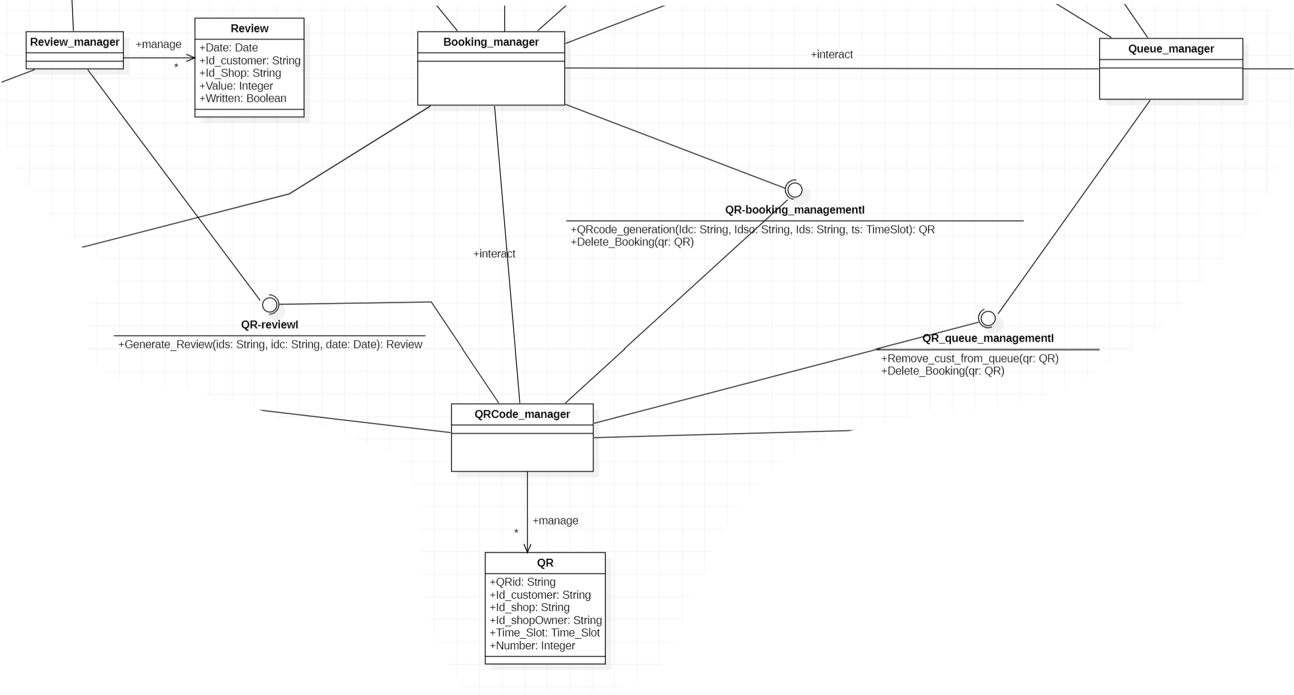
UML architectural - Components
𝙸𝚚𝚞𝚎𝚞𝚎
Components
Booking_manager:
It supervises the bookings of the time slots from the Customers
QRcode_manager:
It focuses on the QR management
Queue_manager:
It coordinates the queue counter coherently with the bookings
Review_manager:
It focuses on the reviews management
Giacomelli, Gottardini, Veronese

Slide 47
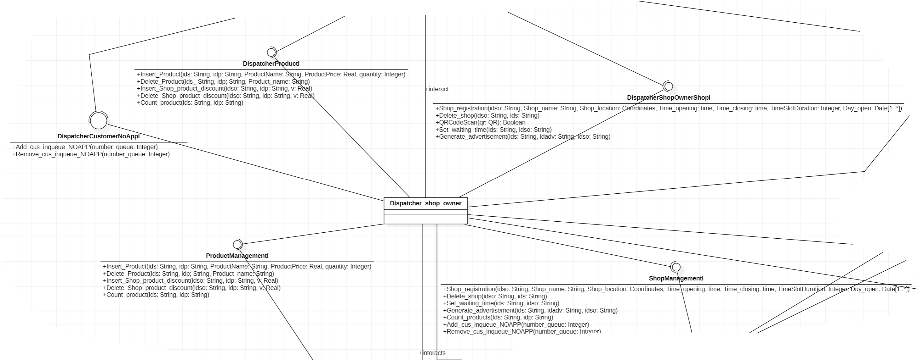
UML architectural - Components
𝙸𝚚𝚞𝚎𝚞𝚎
Components
Dispatcher_ShopOwner:
Same role of the dispatcher_customer, but it is focused on the Shop Owner activities.
Giacomelli, Gottardini, Veronese

Slide 48
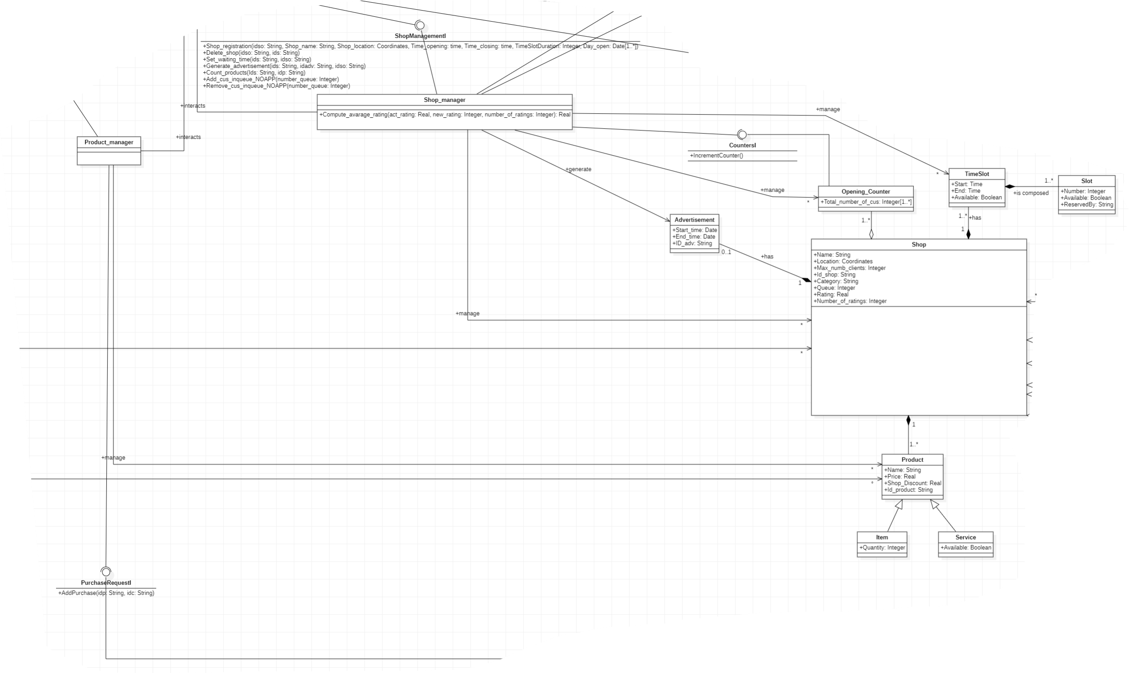
UML architectural - Components
𝙸𝚚𝚞𝚎𝚞𝚎
Components
Shop_manager:
It has functionalities both on Shop Owner side and on Customer side: it collects the shop information and manages the Customer requests.
Product_manager:
It responsible for the product
Connected both to the Customer and to the Shops
Giacomelli, Gottardini, Veronese

Slide 49



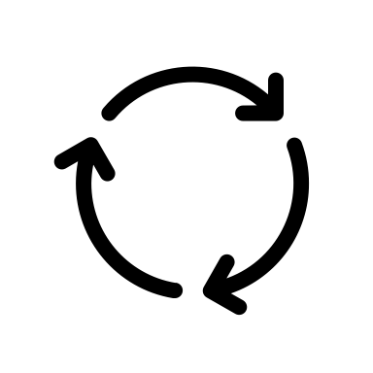
UML architectural - Interfaces
𝙸𝚚𝚞𝚎𝚞𝚎
Interfaces
The interfaces represent the connection and the boundaries between the different components of the system. They are often characterized by operations which may be invoked when passing from one module to the other.
They are fundamental since they enable modularity and flexibility in software design. They allow us to define interchangeable components that can be easily swapped or extended without affecting the rest of the codebase, permitting information hiding and design for change.
Giacomelli, Gottardini, Veronese

Slide 50
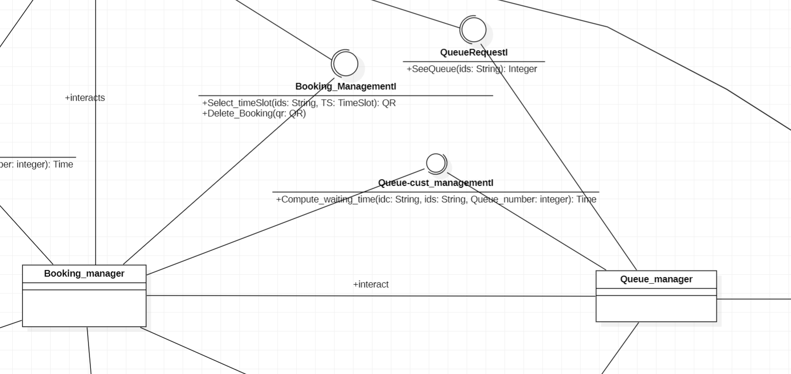
UML architectural - Interfaces
𝙸𝚚𝚞𝚎𝚞𝚎
Interfaces
selectionI:
Allows the user to select its role in the Iqueue application
booking_ManagementI:
Deals with the booking
Allows to select the time slot and delete the booking
Queue-cust_managementI:
Computes the time that a Customer should wait
QueueRequestI:
Allows to see the number of people in queue
Giacomelli, Gottardini, Veronese

Slide 51
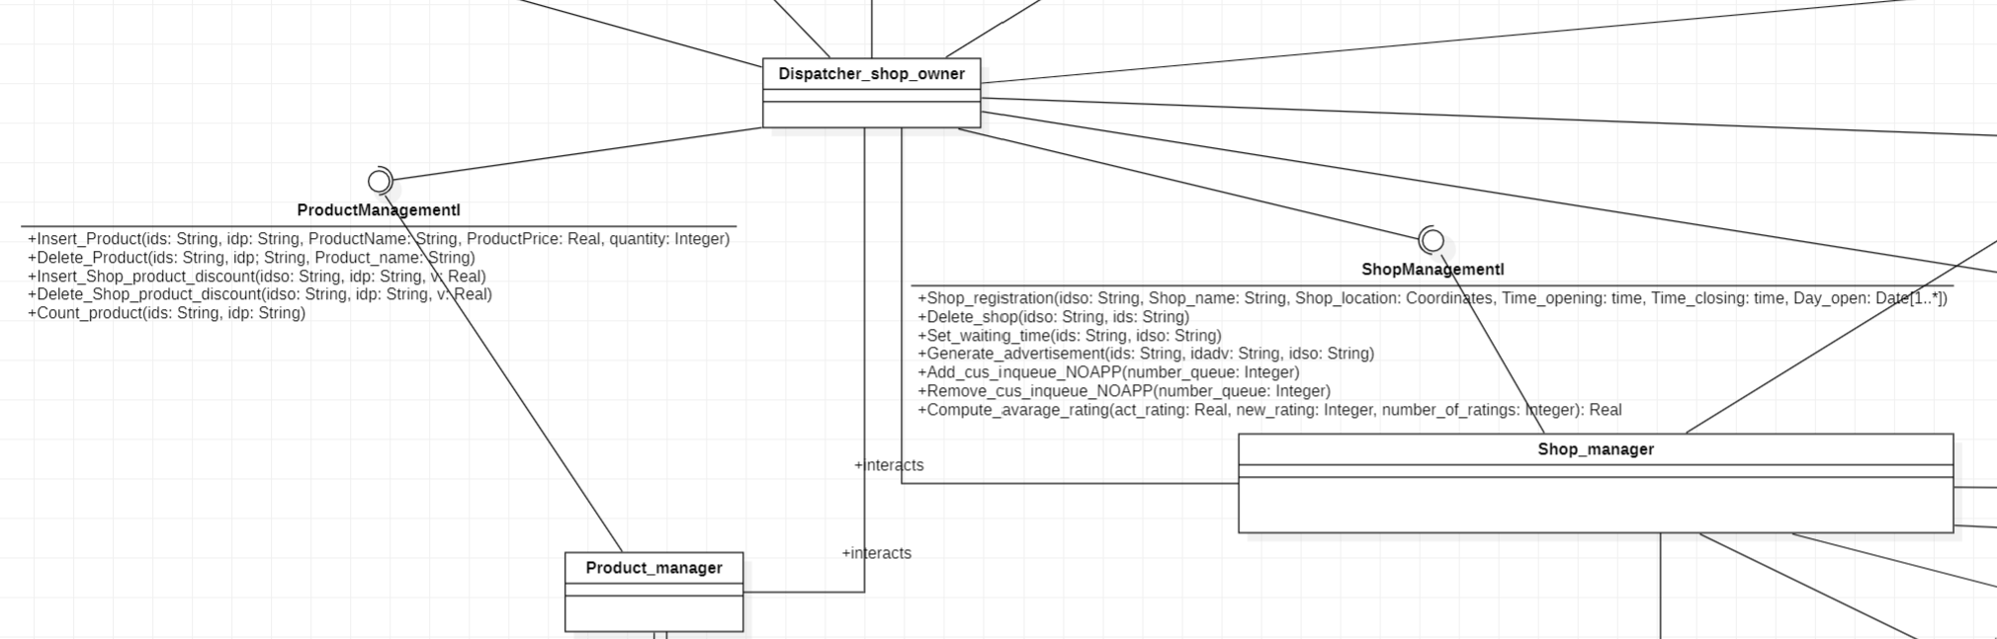
UML architectural - Interfaces
𝙸𝚚𝚞𝚎𝚞𝚎
Interfaces
ShopManagementI:
Allows to register or delete the shop, generate advertisement, ADD and DEC manually the people in queue
ProductManagementI:
Allows the register and delete products and their discounts.
Allows the Shop Owner to keep track of the number of products
Giacomelli, Gottardini, Veronese

Slide 52
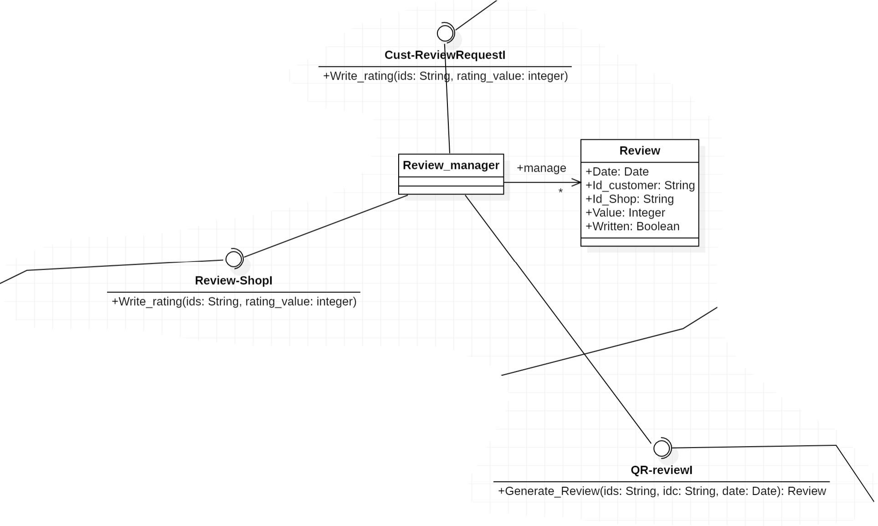
UML architectural - Interfaces
𝙸𝚚𝚞𝚎𝚞𝚎
Interfaces
Cust-shopRequestI:
Links the Customer with the Shop, allowing the customer to see and select them on the map
Cust-ReviewRequestI:
Permits the customer to write a rating for a Shop
Review-ShopI:
Permits to propagate the written rating to the relative Shop
QR-reviewI:
Grant the generation of the review
Giacomelli, Gottardini, Veronese

Slide 53
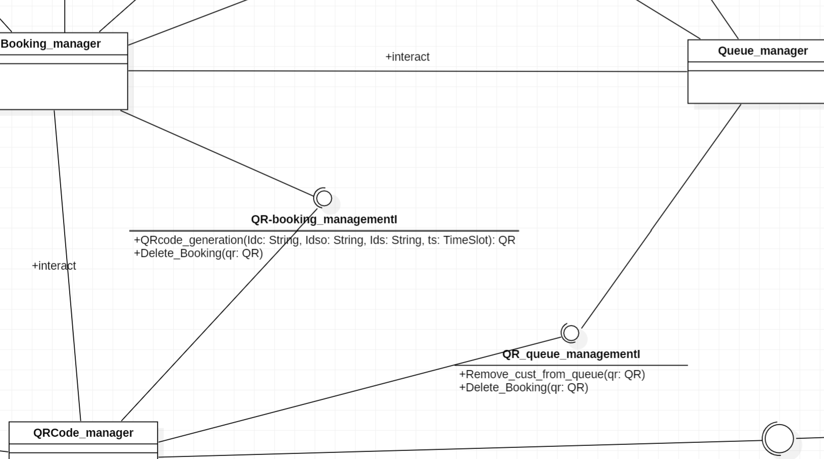
UML architectural - Interfaces
𝙸𝚚𝚞𝚎𝚞𝚎
Interfaces
QR-booking_managementI :
Allows to generate a QR after a booking
QR_queue_managementI:
Every time a QR code has been scanned the corresponding Customer is removed from the Queue
QR-Shop_owner_managementI:
Permits the Shop Owner to scan the QRs
Giacomelli, Gottardini, Veronese

Slide 54
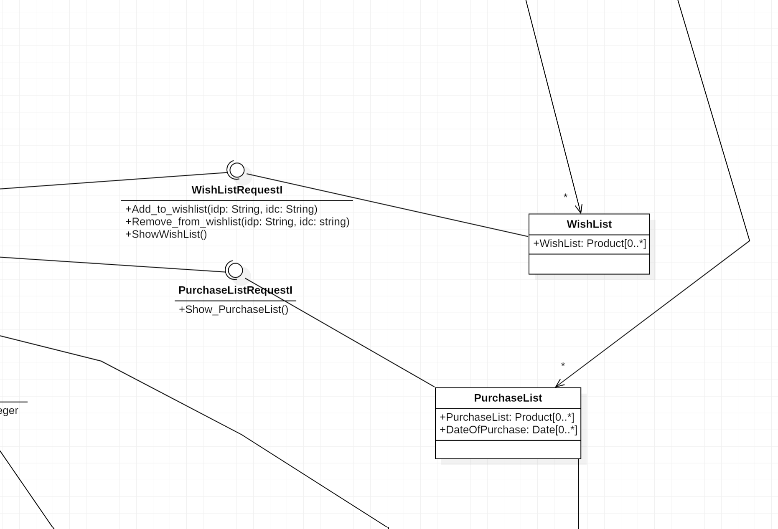
UML architectural - Interfaces
𝙸𝚚𝚞𝚎𝚞𝚎
Interfaces
Wish List RequestI:
Adds, removes and shows products in the Customer whishlist
PurchaseRequestI:
Allows the Customer to see its purchase list of products.
Giacomelli, Gottardini, Veronese

Slide 55
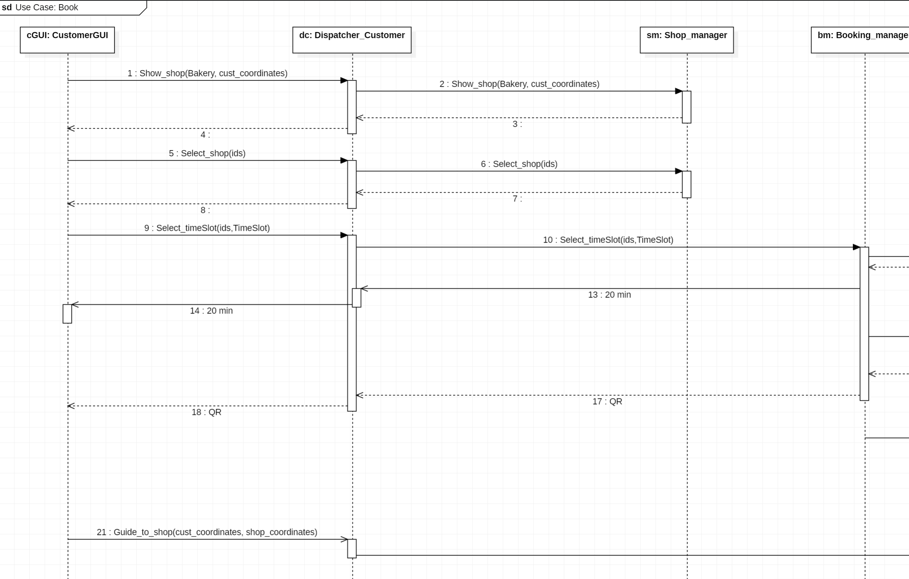
UML requirement – Sequence Diagrams
𝙸𝚚𝚞𝚎𝚞𝚎
Book Sequence Diagrams
PT. 1
Giacomelli, Gottardini, Veronese

Slide 56
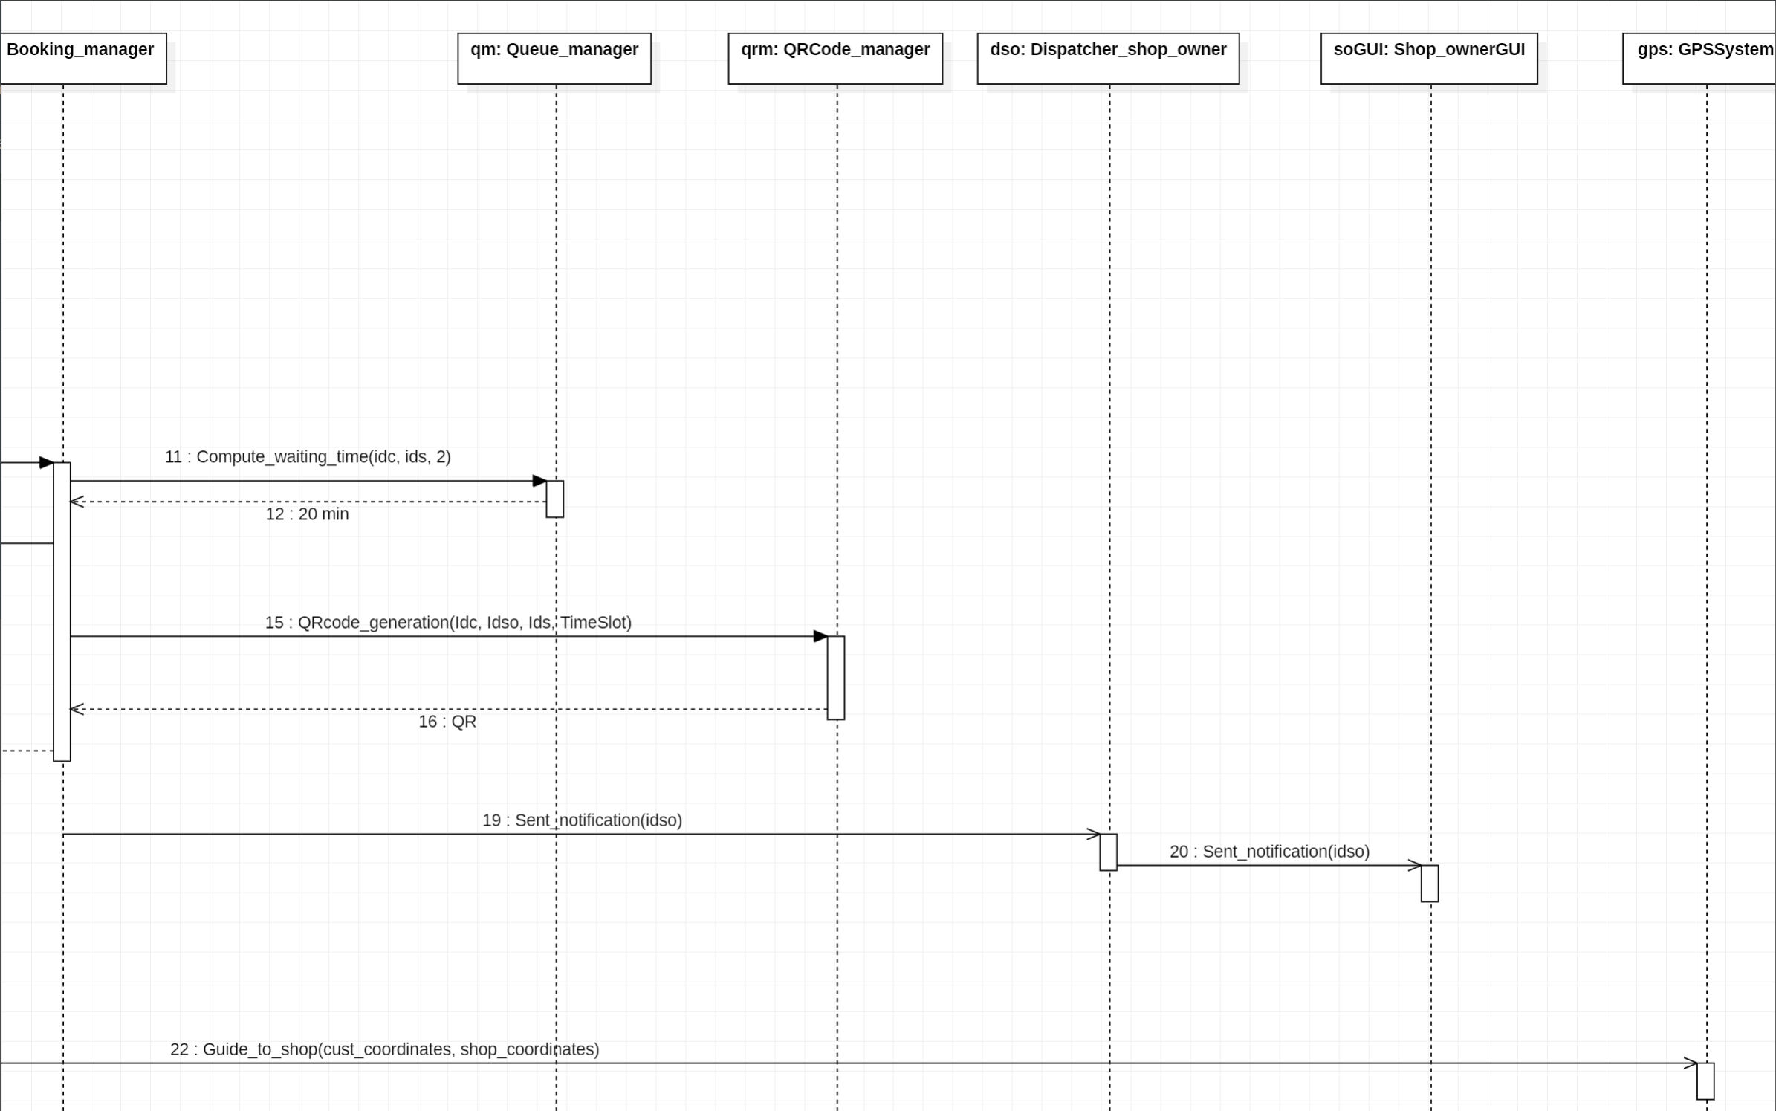
UML architectural – Sequence Diagrams
𝙸𝚚𝚞𝚎𝚞𝚎
Book Sequence Diagrams
PT. 2
Giacomelli, Gottardini, Veronese

Slide 57
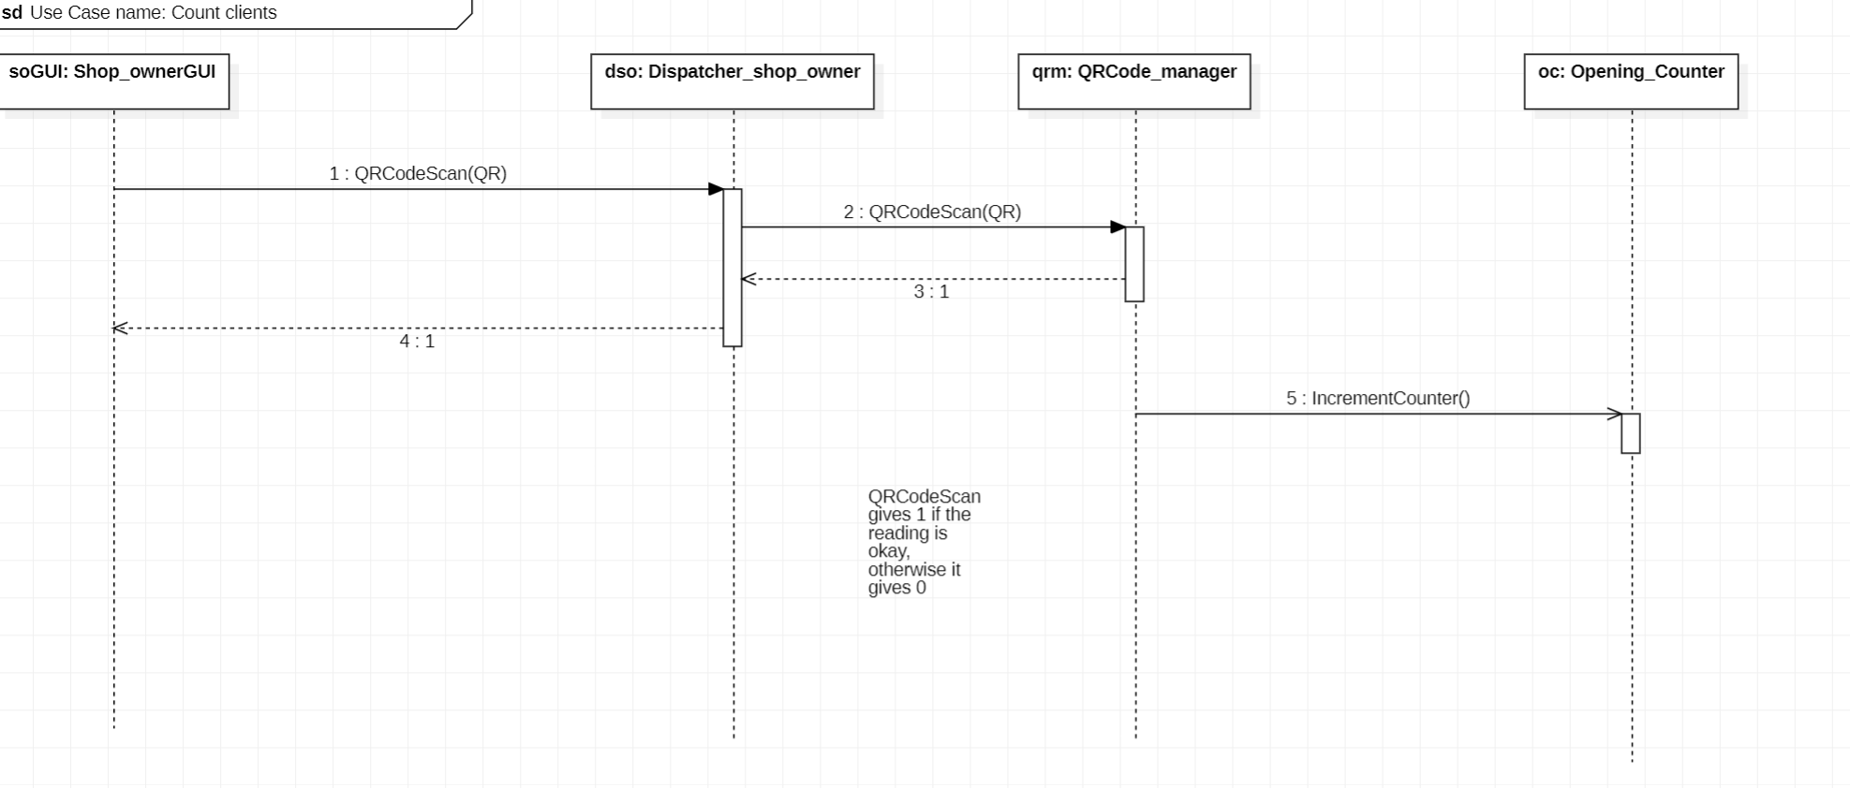
UML architectural – Sequence Diagrams
𝙸𝚚𝚞𝚎𝚞𝚎
Count client Sequence Diagrams
Giacomelli, Gottardini, Veronese

Slide 58
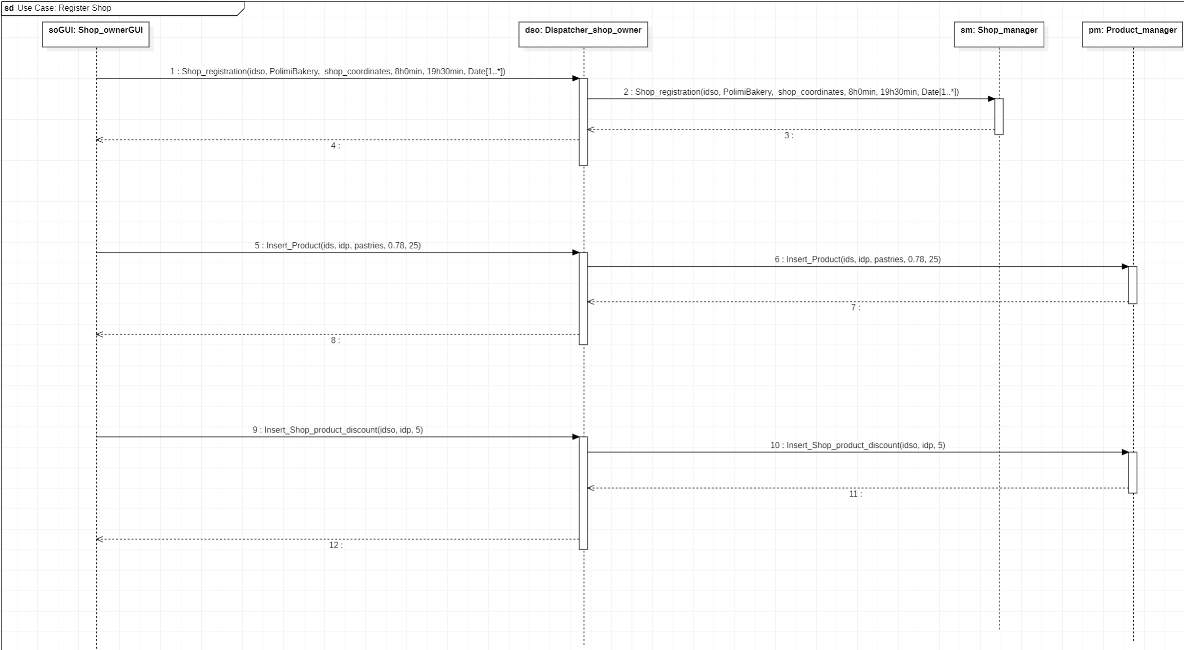
UML architectural – Sequence Diagrams
𝙸𝚚𝚞𝚎𝚞𝚎
Register shop Sequence Diagrams
Giacomelli, Gottardini, Veronese

Slide 59
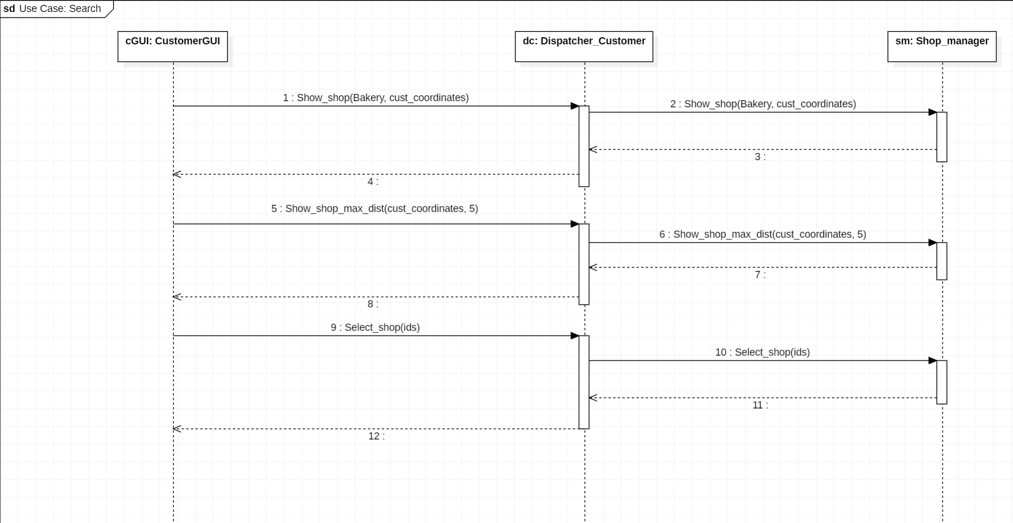
UML architectural – Sequence Diagrams
𝙸𝚚𝚞𝚎𝚞𝚎
Search Sequence Diagrams
Giacomelli, Gottardini, Veronese

Slide 60
Implementation
𝙸𝚚𝚞𝚎𝚞𝚎
𝙸𝚚𝚞𝚎𝚞𝚎
Giacomelli, Gottardini, Veronese

Slide 61
Content
𝙸𝚚𝚞𝚎𝚞𝚎
1. Feasibility study
2. Requirement analysis
3. Design analysis
4. Implementation
5. Testing
UML requirements
UML architectural
Giacomelli, Gottardini, Veronese

Slide 62



Implementation
𝙸𝚚𝚞𝚎𝚞𝚎
This document aims to provide a detailed guideline for implementing the Iqueue app. It will offer a clear and concise overview of the Django framework's architectural components that make up the app. Additionally, it will outline the implemented requirements and their corresponding functions, along with a user manual for the app. The objective is to present the information in a more comprehensible and articulate manner.
Framework
Code Structure
Requirements
Giacomelli, Gottardini, Veronese

Slide 63
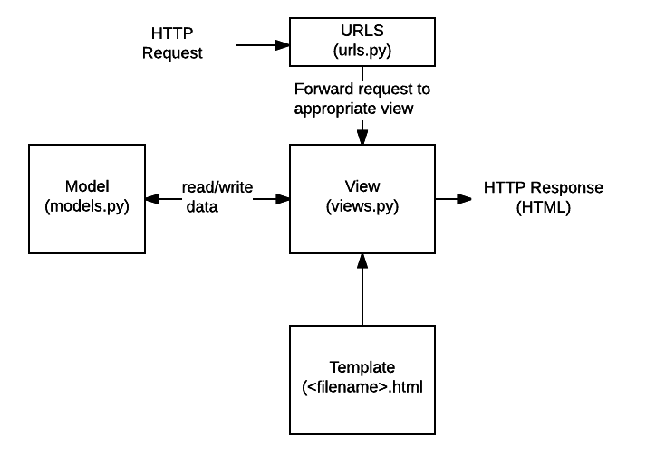
Implementation - Frameworks
𝙸𝚚𝚞𝚎𝚞𝚎
Django
User interacts with the application
Request routing
Request processing in the view
Database interaction
Request processing in the view
Template (visual interface) loaded
Response to the client
Giacomelli, Gottardini, Veronese

Slide 64
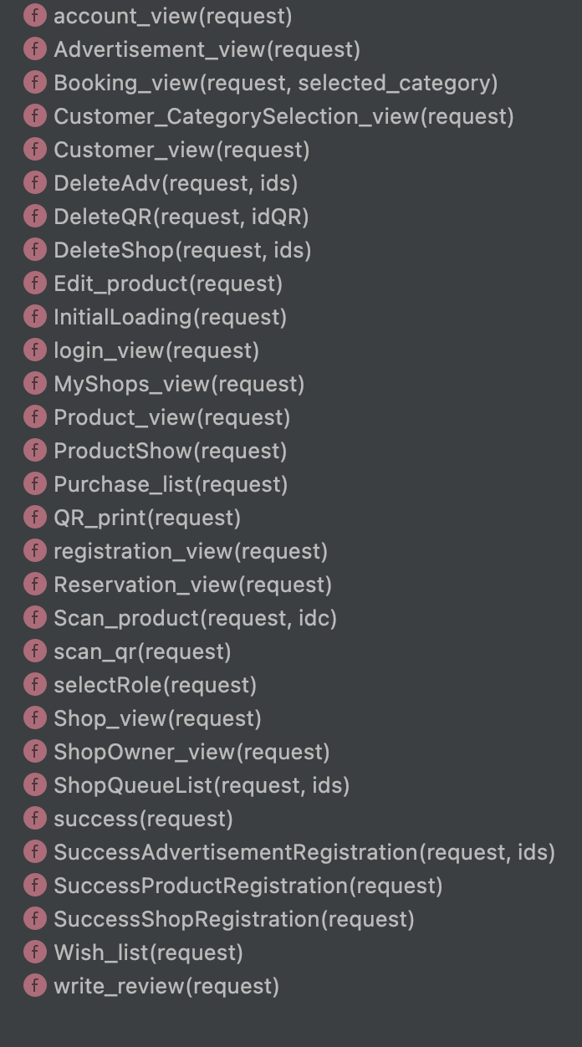
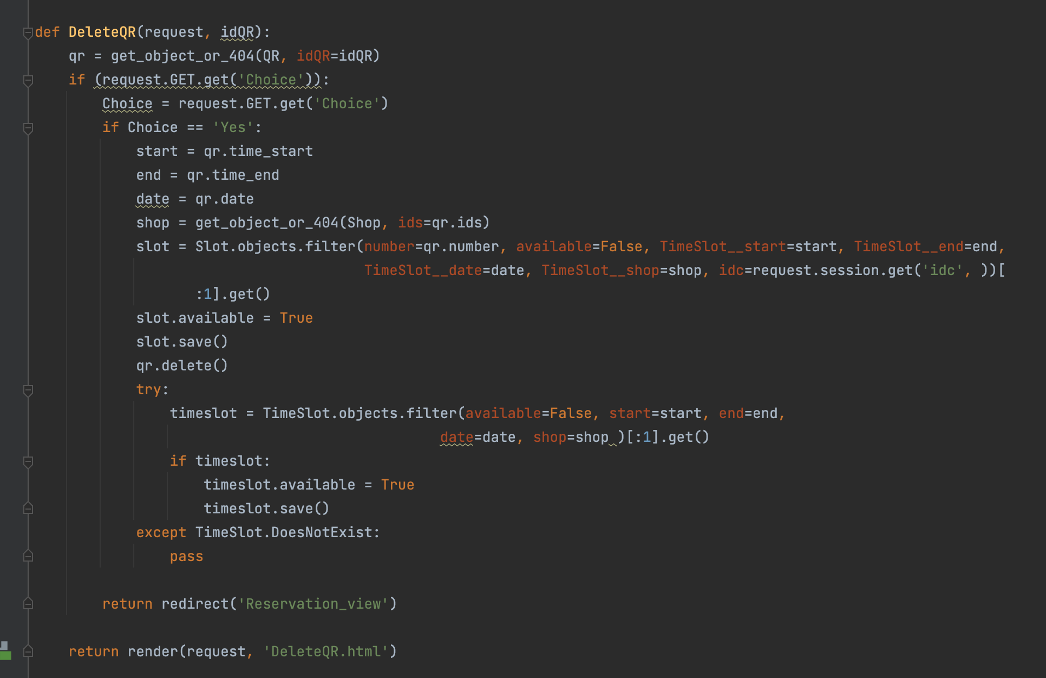
Implementation – Code Structure
𝙸𝚚𝚞𝚎𝚞𝚎
Views.py
The views.py file in Django contains the views or functions that handle HTTP requests and generate HTTP responses.
Figure 1: views.py
Figure 1: views.py
Figure 2: structure of views.py
Giacomelli, Gottardini, Veronese

Slide 65
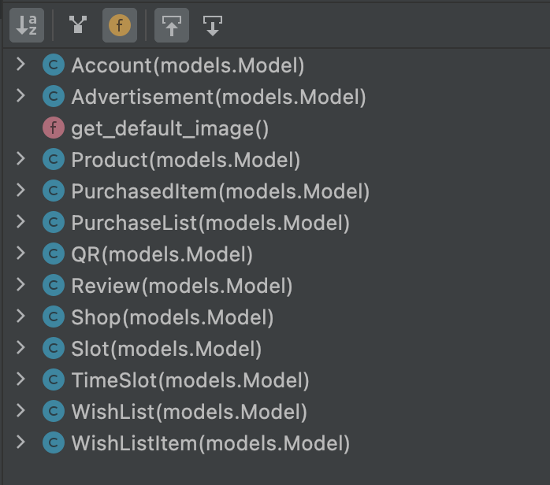
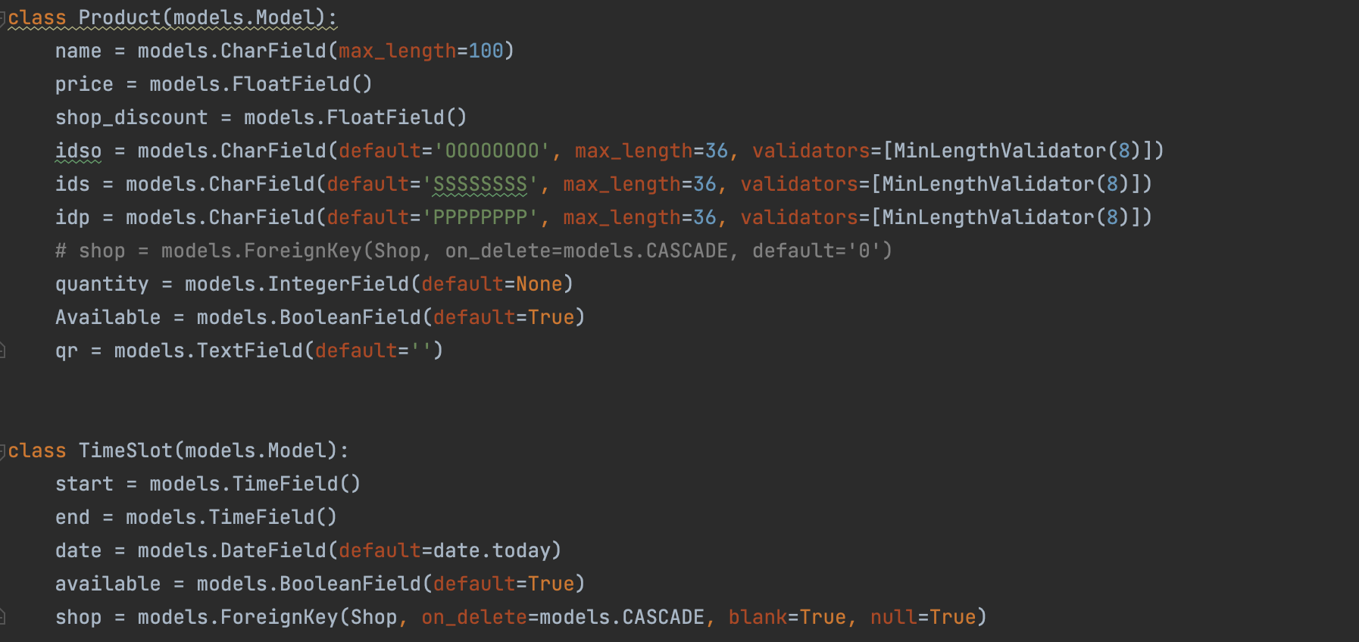
Implementation – Code Structure
𝙸𝚚𝚞𝚎𝚞𝚎
forms.py
The forms.py file in Django is commonly used to define form classes. These form classes provide a convenient way to handle form input and validation in web applications.
models.py
In Django, models.py is used to define the structure and behavior of database tables. Each model class represents a table in the database, and the fields within the class correspond to the columns in the table.
Figure 2: models.py
Figure 2: structure of models.py
Giacomelli, Gottardini, Veronese

Slide 66
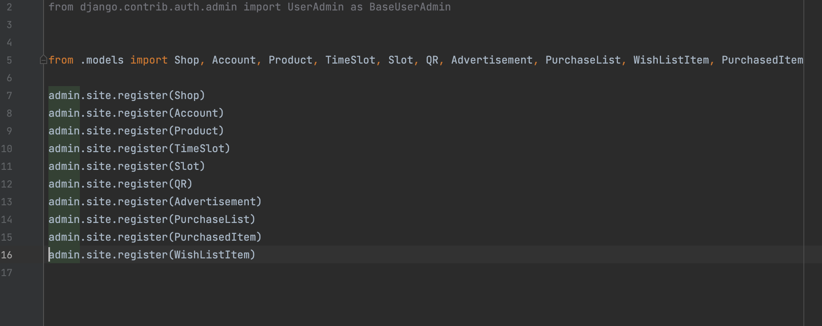
Implementation – Code Structure
𝙸𝚚𝚞𝚎𝚞𝚎
admin.py
The main purpose of "admin.py" is to allow developers to easily define how the models in their application should be presented and manipulated in the Django administration interface.
Figure 1: admin.py
Giacomelli, Gottardini, Veronese

Slide 67
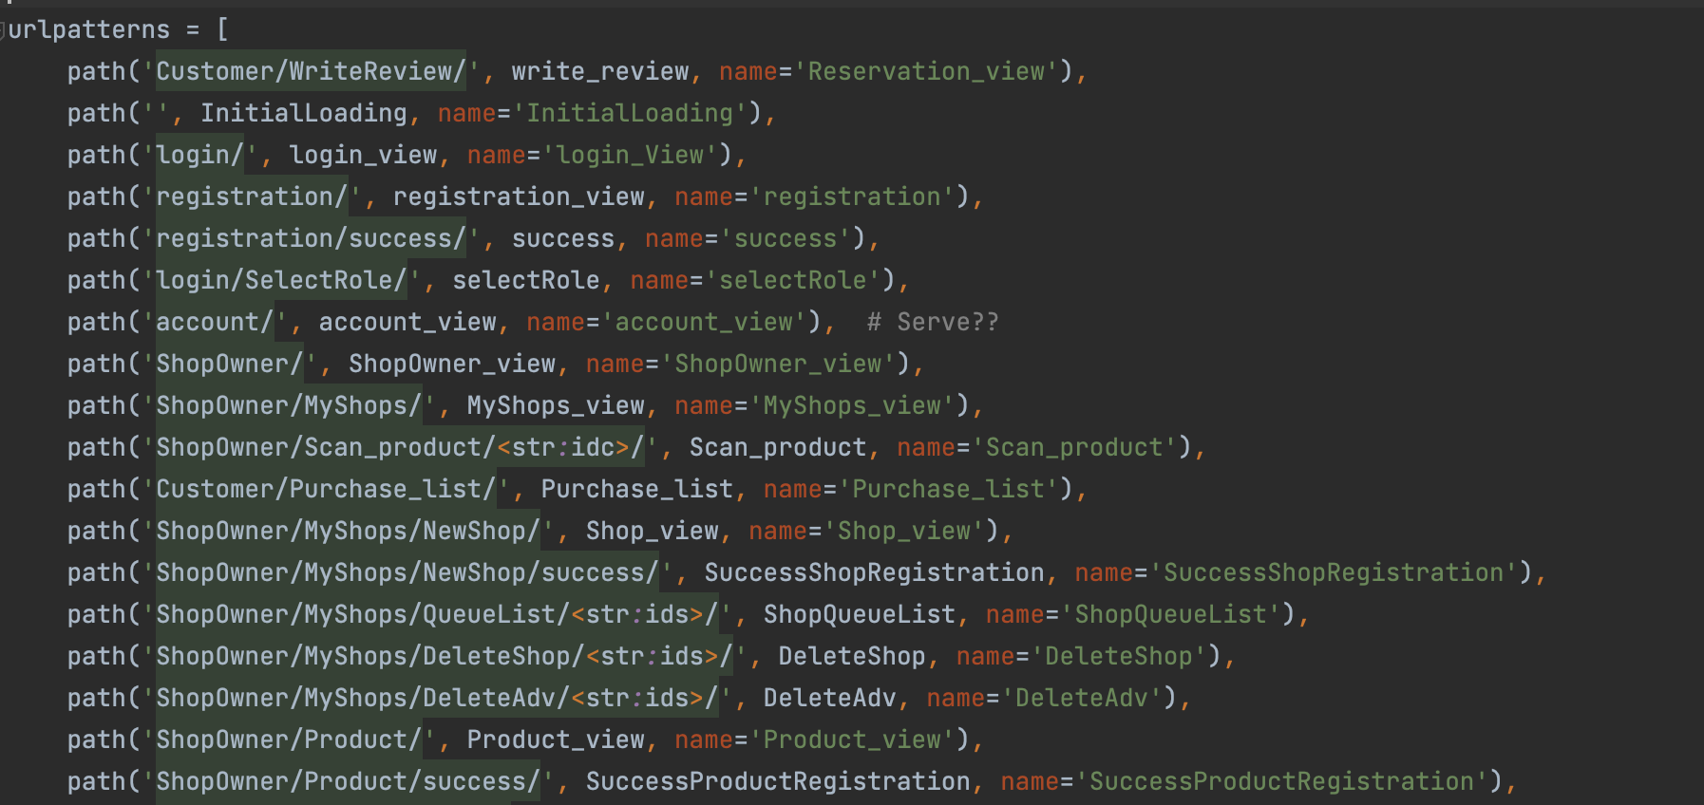
Implementation – Code Structure
𝙸𝚚𝚞𝚎𝚞𝚎
Settings.py
The settings.py file in Django contains various configurations and settings for the Django project
Figure 1: admin.py
Giacomelli, Gottardini, Veronese

Slide 68
Implementation - Requirements
𝙸𝚚𝚞𝚎𝚞𝚎
Requirements
R27
R29
R28
R25
R28
R27
R26
R25 | Iqueue must allow user registration
R26 | Iqueue must allow the user to operate as customer or as shop owner
R27 | Iqueue must allow log-in as customer
R28 | Iqueue must allow log-in as shop owner
R29 | Iqueue must allow log-out
Giacomelli, Gottardini, Veronese

Slide 69
Implementation - Requirements
𝙸𝚚𝚞𝚎𝚞𝚎
Requirements
R11
R5, R24
R11
R40
R35
R12, R19, R34, R39
R41
R1, R32
R18
R6, R17
R40
R18
R1, R32
R6, R17
R41
R1 | Iqueue must allow the customers to see the number of people in the queue at a specific shop
R5 | The app shall allow customers to track their rewards
R32 | Iqueue will be able to realize to queue counting by means of the QR codes
R24 | The app must be able to track customer rewards and loyalty points
R41 | Iqueue will allow the client to provide feedback and rating to the shops
R11 | The app shall show the customer's purchase history and receipts
R6 | Iqueue must allow a customer to book a time slot on the app to visit the shop
R12 | The app will be able to divide the registered facilities into categories
R17 | Iqueue must show the available time slots of a shop
R19 | The app will show the registered shops on a map/list
R18 | Iqueue must permit a customer to delete his booked time slot
R34 | Iqueue shall allow the customer to select the category of the shops he is interested to visit
R40 | Iqueue shall give the shop address to a third-party GPS system to guide the client to the shop
R39 | The app shows the user of the interested queue variation
R35 | Iqueue shall allow the customer to select a specific shop
R41 | Iqueue will allow the client to provide feedback and rating to the shops
Giacomelli, Gottardini, Veronese

Slide 70
Implementation - Requirements
𝙸𝚚𝚞𝚎𝚞𝚎
Requirements
R21,30
R13, R14, R31
R3, R22
R7, R16
R21, R23
R2
R38
R33
R33
R41
R13 | The app will permit the shop owner to insert their products/services
R41 | Iqueue will allow the client to provide feedback and rating to the shops
R14 | The app will enable shop owners to insert the price of their products/services
R23 | Iqueue shall allow the shop owners to delete special offers for their shop
R31 | The app will enable shop owners to count their available products/services
R7 | Iqueue must keep track of the customer position
R21 | Iqueue shall permit the shop owners to delete the data of their activity
R16 | Iqueue must be able to generate the client QR code
R30 | The app will enable shop owners to remove their products/services
R2 | Iqueue shall allow the shop owners to insert the data of their activity
R3 | Iqueue shall allow the shop owners to insert special offers for their shop
R38 | The app shall allow the shop owner to advertise their shop
R22 | Iqueue shall allow the shop owners to modify special offers for their shop
R33 | Iqueue will allow the shop owner to manually increment or decrement the queue counter
Giacomelli, Gottardini, Veronese

Slide 71
Implementation - Requirements
𝙸𝚚𝚞𝚎𝚞𝚎
Requirements
R18
R7, R16
R32
R18
R7 | Iqueue must keep track of the customer position
R18 | Iqueue must permit a customer to delete his booked time slot
R32 | Iqueue will be able to realize to queue counting by means of the QR codes
R16 | Iqueue must be able to generate the client QR code
Giacomelli, Gottardini, Veronese

Slide 72
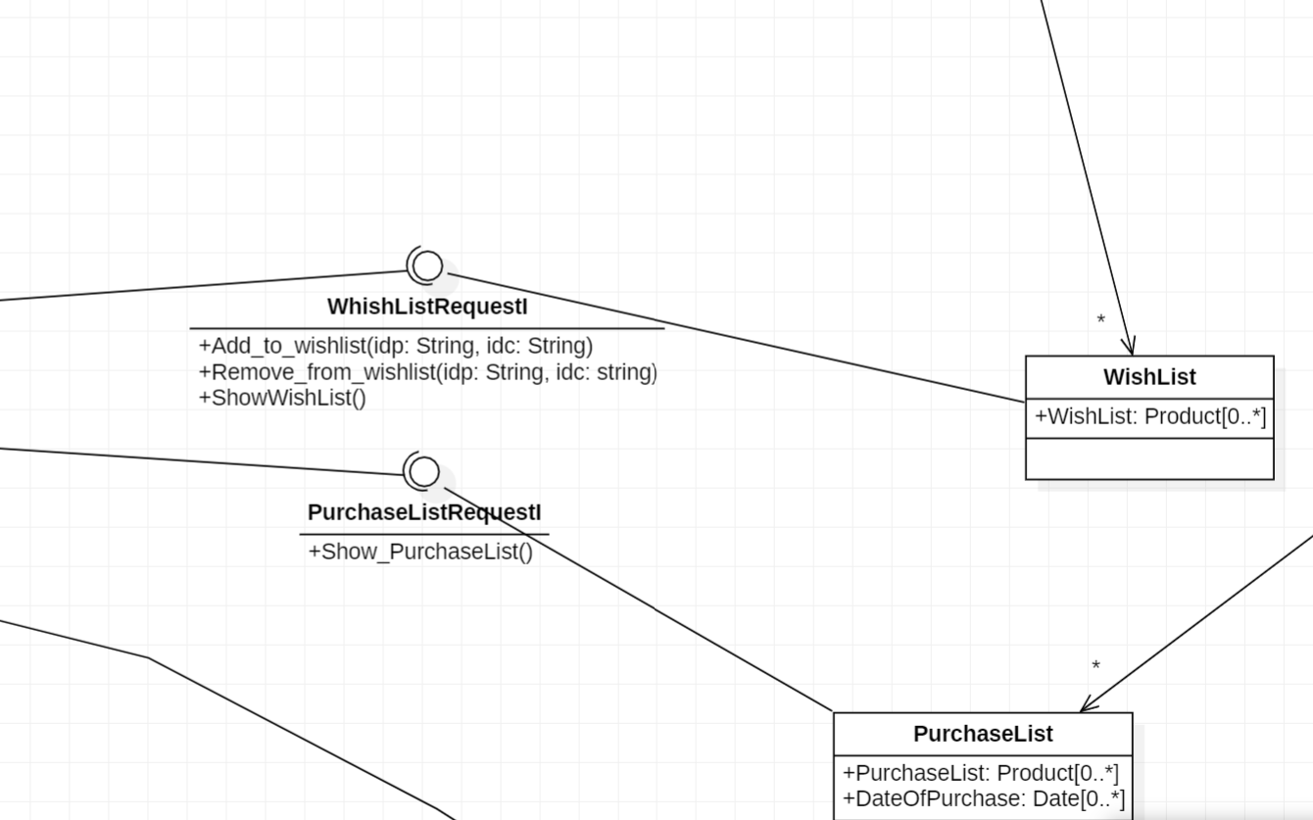
Implementation - Requirements
𝙸𝚚𝚞𝚎𝚞𝚎
Requirements
R10
R11
R10
R11
R10 | The app shall allow customers to create and save shopping lists or wish lists.
R11 | The app shall show the customer's purchase history and receipts
Giacomelli, Gottardini, Veronese

Slide 73
Testing
𝙸𝚚𝚞𝚎𝚞𝚎
𝙸𝚚𝚞𝚎𝚞𝚎
Giacomelli, Gottardini, Veronese

Slide 74
Content
𝙸𝚚𝚞𝚎𝚞𝚎
1. Feasibility study
2. Requirement analysis
3. Design analysis
4. Implementation
5. Testing
UML requirements
UML architectural
Giacomelli, Gottardini, Veronese

Slide 75
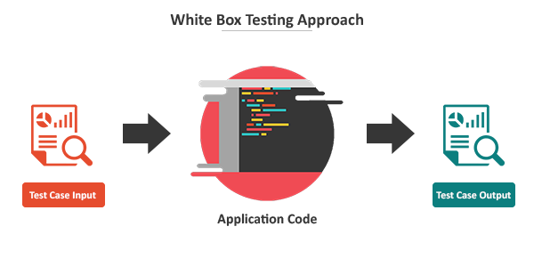
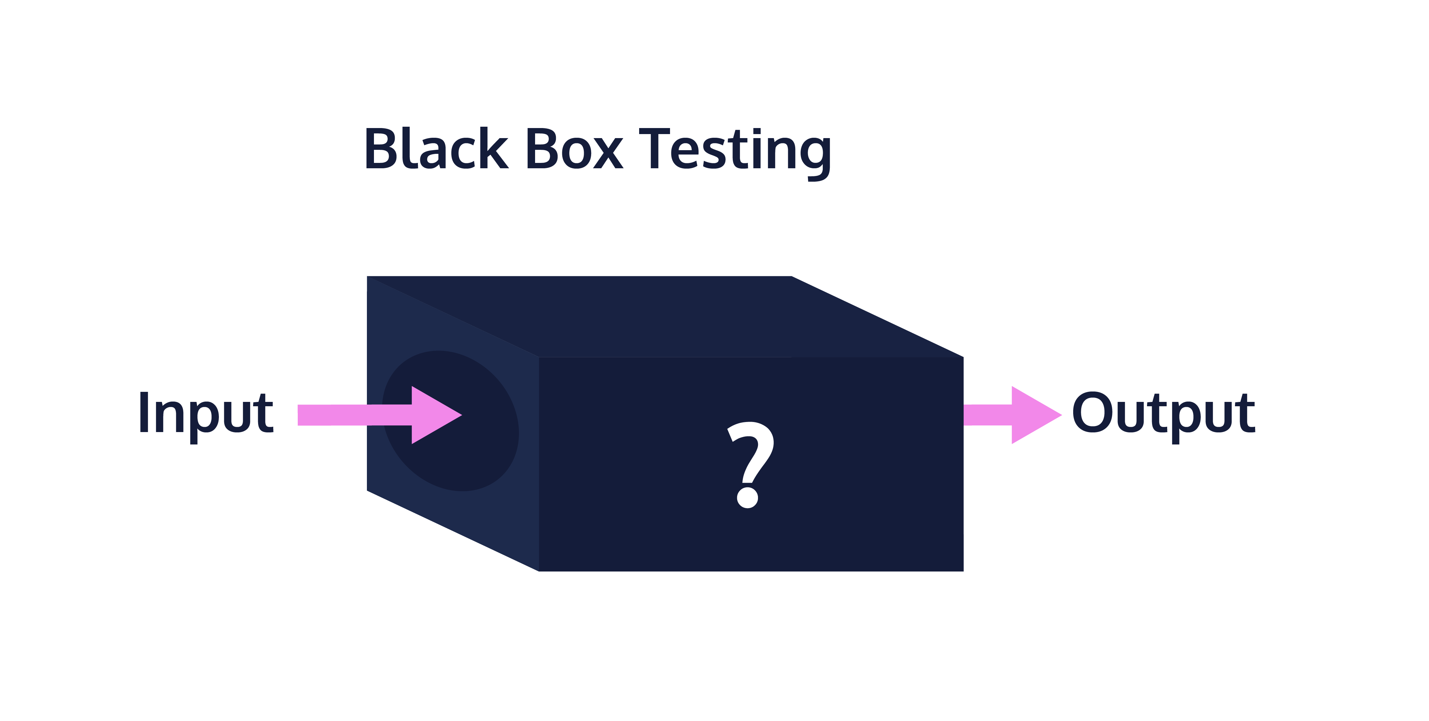
Testing
𝙸𝚚𝚞𝚎𝚞𝚎
The testing documentation helps to explain the different testing benchmarks applied to the Iqueue software. As Dijkstra stated, “Program testing can be used to show the presence of bugs, but never to show their absence”.
White box testing
Black Box testing
Giacomelli, Gottardini, Veronese

Slide 76
Testing – White Box
𝙸𝚚𝚞𝚎𝚞𝚎
White Box
We choose to test the code related to the booking view
Test sets employed in the white-box testing will be identified based on the following criteria:
• Statement Coverage
• Edge Coverage
• Condition Coverage
• Path Coverage
Coverage-based test evaluation to assess the test validity:
Giacomelli, Gottardini, Veronese

Slide 77

Testing – White Box
𝙸𝚚𝚞𝚎𝚞𝚎
White Box
Control Flow graph
Giacomelli, Gottardini, Veronese

Slide 78


Testing – White Box
𝙸𝚚𝚞𝚎𝚞𝚎
White Box
Inputs
Before dealing with the different control flow coverage criteria, a description of the inputs of the test cases is provided:
• selected_category: it is the category of shops selected by the customer.
• date: it is the day the costumer wants to make its reservation.
• shop_ids: it is the ID code associated with the shop selected by the customer. It is described by a string of 36 characters.
• btnform1: button that sends the first form (see above). True means that the button has been pressed, false that it has not been pressed.
• btnform2: button that sends the second form (see above). True means that the button has been pressed, false that it has not been pressed.
• selected_slot: id assigned by Django to the TimeSlot object to record it in the database.
btnform1
When we reach the return render(request,'booking.html', context=… ) statement, we consider ending the test case.
btnform2
Giacomelli, Gottardini, Veronese

Slide 79
Testing – White Box
𝙸𝚚𝚞𝚎𝚞𝚎
White Box
Statement coverage
{ < selected_category = Bakery, btnform1 = FALSE, date = None, shop_ids = a7b8da0f-b6ba-4f69-9b4e-119181849180, btnform2 = FALSE, selected_slot = None>,
< selected_category = Bakery, btnform1 = TRUE, date = 17.05.2024, shop_ids = a7b8da0f-b6ba-4f69-9b4e-119181849180, btnform2 = FALSE, selected_slot = None>,
< selected_category = Bakery, btnform1 = TRUE, date = 17.05.2023, shop_ids = a7b8da0f-b6ba-4f69-9b4e-119181849180, btnform2 = FALSE, selected_slot = None>,
< selected_category = Bakery, btnform1 = FALSE, date = None, shop_ids = None, btnform2 = TRUE, selected_slot = 268954>}
Number of statements covered = 54
Total number of statements = 55 (including the HTTP 404 exception)
Percentage of coverage = 98%
Giacomelli, Gottardini, Veronese

Slide 80
Testing – White Box
𝙸𝚚𝚞𝚎𝚞𝚎
White Box
Edge Coverage
{ < selected_category = Bakery, btnform1 = FALSE, date = None, shop_ids = a7b8da0f-b6ba-4f69-9b4e-119181849180, btnform2 = FALSE, selected_slot = None>,
< selected_category = Bakery, btnform1 = TRUE, date = 17.05.2024, shop_ids = a7b8da0f-b6ba-4f69-9b4e-119181849180, btnform2 = FALSE, selected_slot = None>,
< selected_category = Bakery, btnform1 = TRUE, date = 17.05.2023, shop_ids = a7b8da0f-b6ba-4f69-9b4e-119181849180, btnform2 = FALSE, selected_slot = None>,
< selected_category = Bakery, btnform1 = FALSE, date = None, shop_ids = None, btnform2 = TRUE, selected_slot = 268954>,
< selected_category = Bakery, btnform1 = FALSE, date = None, shop_ids = None, btnform2 = TRUE, selected_slot = 268975>}
Number of edges covered = 20
Total number of edges = 22 (including the HTTP 404 exception)
Percentage of coverage = 91%
Giacomelli, Gottardini, Veronese

Slide 81
Testing – White Box
𝙸𝚚𝚞𝚎𝚞𝚎
White Box
Condition Coverage
{< selected_category = Others, btnform1 = FALSE, date = None, shop_ids = a7b8da0f-b6ba-4f69-9b4e-119181849180, btnform2 = FALSE, selected_slot = None>,
< selected_category = Bakery, btnform1 = FALSE, date = None, shop_ids = a7b8da0f-b6ba-4f69-9b4e-119181849180, btnform2 = FALSE, selected_slot = None>,
< selected_category = Bakery, btnform1 = TRUE, date = 17.05.2024, shop_ids = a7b8da0f-b6ba-4f69-9b4e-119181849180, btnform2 = FALSE, selected_slot = None>,
< selected_category = Bakery, btnform1 = TRUE, date = 17.05.2023, shop_ids = a7b8da0f-b6ba-4f69-9b4e-119181849180, btnform2 = FALSE, selected_slot = None>,
< selected_category = Bakery, btnform1 = FALSE, date = None, shop_ids = None, btnform2 = TRUE, selected_slot = 268954>,
< selected_category = Bakery, btnform1 = FALSE, date = None, shop_ids = None, btnform2 = TRUE, selected_slot = 268975>}
Number of conditions covered = 10
Total number of conditions = 13 (including the HTTP 404 exception)
Percentage of coverage = 77%
Giacomelli, Gottardini, Veronese

Slide 82
Testing – White Box
𝙸𝚚𝚞𝚎𝚞𝚎
White Box
Path Coverage
{< selected_category = Others, btnform1 = FALSE, date = None, shop_ids = a7b8da0f-b6ba-4f69-9b4e-119181849180, btnform2 = FALSE, selected_slot = None>,
< selected_category = Bakery, btnform1 = FALSE, date = None, shop_ids = a7b8da0f-b6ba-4f69-9b4e-119181849180, btnform2 = FALSE, selected_slot = None>,
< selected_category = Bakery, btnform1 = TRUE, date = 17.05.2024, shop_ids = a7b8da0f-b6ba-4f69-9b4e-119181849180, btnform2 = FALSE, selected_slot = None>,
< selected_category = Bakery, btnform1 = TRUE, date = 17.05.2023, shop_ids = a7b8da0f-b6ba-4f69-9b4e-119181849180, btnform2 = FALSE, selected_slot = None>,
< selected_category = Bakery, btnform1 = FALSE, date = None, shop_ids = None, btnform2 = TRUE, selected_slot = 268954>,
< selected_category = Bakery, btnform1 = FALSE, date = None, shop_ids = None, btnform2 = TRUE, selected_slot = 268975>}
Number of paths covered = 6
Total number of paths = 8 (including the HTTP 404 exception)
Percentage of coverage = 75%
Giacomelli, Gottardini, Veronese

Slide 83
Testing – White Box
𝙸𝚚𝚞𝚎𝚞𝚎
White Box
Statement coverage
Edge Coverage
Number of statements covered = 54
Total number of statements = 55 (including the HTTP 404 exception)
Percentage of coverage = 98%
Number of edges covered = 20
Total number of edges = 22 (including the HTTP 404 exception)
Percentage of coverage = 91%
Condition Coverage
Path Coverage
Number of conditions covered = 10
Total number of conditions = 13 (including the HTTP 404 exception)
Percentage of coverage = 77%
Number of paths covered = 6
Total number of paths = 8 (including the HTTP 404 exception)
Percentage of coverage = 75%
Giacomelli, Gottardini, Veronese

Slide 84
Testing – White Box
𝙸𝚚𝚞𝚎𝚞𝚎
White Box
Overall results (Booking view)
Based on the performed testing, we can conclude that the booking view is significatively robust: this is due not only to the here reported view code but also to the implementation of the webpage template.
The items that are not covered by the test set above are not an issue thanks to the well-structure of the webpage template.
Giacomelli, Gottardini, Veronese

Slide 85
Testing – White Box
𝙸𝚚𝚞𝚎𝚞𝚎
White Box
We remember that the condition coverage and the path coverage are finer than the edge coverage that is finer than the statement coverage. When a criteria is finer than another this means that for any test sets satisfying the first there is a subset of it that also satisfies the latter. This is reflected by the test sets implemented by us.
A weakness of all of the white-box techniques is that the focus on the code, but they do not tackling directly on the specifications.
To realize a complete and exhaustive testing campaign, black-box techniques will be considered.
Giacomelli, Gottardini, Veronese

Slide 86
Testing – Black Box
𝙸𝚚𝚞𝚎𝚞𝚎
Black Box
Test Case 1: Standard case
Goal: To show that the account registration code will allow to register a new user if all the inputs are correct.
Input: Birthday: 01/02/1999, Email: niccoloenrico.veronese@mail.polimi.it (not already used)
Expected output: Registration successfully completed.
Actual output: Registration successfully completed and a new account is created.
Account registration
Giacomelli, Gottardini, Veronese

Slide 87

Testing – Black Box
𝙸𝚚𝚞𝚎𝚞𝚎
Black Box
Test Case 2: Birthday after the current date
Goal: To show that the account registration code will not allow to insert an invalid birthday
Input: Birthday: 10/7/2050
Expected output: The birthday cannot be in the future
Actual output:
Account registration
Giacomelli, Gottardini, Veronese

Slide 88

Testing – Black Box
𝙸𝚚𝚞𝚎𝚞𝚎
Black Box
Test Case 3: Wrong email
Goal: To prove that the system will not allow to put an incorrect mail in the registration
Input: Email field: niccolo.veronese.it
Expected output: Impossible to create the account without a correct email field.
Actual output:
Account registration
Giacomelli, Gottardini, Veronese

Slide 89

Testing – Black Box
𝙸𝚚𝚞𝚎𝚞𝚎
Black Box
Test Case 4: Account with the same email address of another user
Goal: To guarantee that two user do not have the same email address
Input: Email address: gianluca99.giacomelli@gmail.com (already existing)
Expected output: Validation error: "the given email is already registered"
Actual output:
Account registration
Giacomelli, Gottardini, Veronese

Slide 90
Testing – Black Box
𝙸𝚚𝚞𝚎𝚞𝚎
Black Box
Test Case 1: standard case
Goal: To show that the shop registration code will allow to register a new shop.
Input: Opening time 08:00 and Closing time 18:00
Expected output: Registration successfully completed.
Actual output:Registration successfully completed.
Shop registration
Giacomelli, Gottardini, Veronese

Slide 91

Testing – Black Box
𝙸𝚚𝚞𝚎𝚞𝚎
Black Box
Test Case 2: opening time after the closing time
Goal: To show that the shop registration code will not allow to insert an invalid opening time
Input: Opening time 09:00 and Closing time 08:00
Expected output: “The opening time must be before the closing time”
Actual output:
Shop registration
Giacomelli, Gottardini, Veronese

Slide 92
Testing – Black Box
𝙸𝚚𝚞𝚎𝚞𝚎
Black Box
Test Case 3: Negative max number of clients
Test Case 4: Negative slot durations
Goal: To prove that the system will not allow to put a negative max number of clients
Input: Max number = -2
Expected output: The code will not allow to enter a negative number.
Actual output: The code will not allow to enter a negative number.
Shop registration
Giacomelli, Gottardini, Veronese

Slide 93

Testing – Black Box
𝙸𝚚𝚞𝚎𝚞𝚎
Black Box
Test Case 5: Time slot greater than the total opening time
Goal: To guarantee that the shop owner must not enter a time slot which is greater than the total opening time of the shop.
Input: Opening time 10.30, Closing time 12.00, Slot duration 100 min
Expected output: The code will not allow to register that Shop.
Actual output:
Shop registration
Giacomelli, Gottardini, Veronese

Slide 94

Testing – Black Box
𝙸𝚚𝚞𝚎𝚞𝚎
Black Box
Test Case 1: scan of a QR code
Goal: To show that the Iqueue app is able to scan a QR code for a reservation.
Input: Qr code
Expected output: Scan successfully completed and the reservation disappears.
Actual output:
Booking and QR reading
Giacomelli, Gottardini, Veronese

Slide 95

Testing – Black Box
𝙸𝚚𝚞𝚎𝚞𝚎
Black Box
Test Case 2: scan of an already used QR code
Goal: To show that the Iqueue app will not allow to scan two times the same QR code.
Input: QR code already used.
Expected output: Impossible to scan the QR code.
Actual output:
Booking and QR reading
Giacomelli, Gottardini, Veronese

Slide 96

Testing – Black Box
𝙸𝚚𝚞𝚎𝚞𝚎
Black Box
Test Case 3: Selection of a time slot in the past
Goal: To prove that the system will not allow to book a passed time slot.
Input: Time slot in the past: 31/05/2023
Expected output: The code will not allow to book a time slot in the past.
Actual output:
Booking and QR reading
Giacomelli, Gottardini, Veronese

Slide 97
Testing – Black Box
𝙸𝚚𝚞𝚎𝚞𝚎
Black Box
Test Case 1: Booking for the 15th of June, no customer without Iqueue and actual date (13th of June).
Goal: To show that the Iqueue app can show to the Customer its position in the queue for the selected time slot.
Input: Booking for the 15th of June at the shop Niccolò Enrico Veronese and with no other customers in line on that day in that time slot.
Expected output: The position of the queue is 1.
Actual output:The position in the queue for the selected time slot is 1. Since this test case is developed on the 13th of June the queue in front of the Shop in that moment remains 0.
Queue
Giacomelli, Gottardini, Veronese

Slide 98


Testing – Black Box
𝙸𝚚𝚞𝚎𝚞𝚎
Black Box
Queue
Giacomelli, Gottardini, Veronese

Slide 99
Testing – Black Box
𝙸𝚚𝚞𝚎𝚞𝚎
Black Box
Test Case 2: Booking for the 15th of June, no customer without Iqueue and forced date
Goal: To show that the Iqueue app can increment the number of people in queue in real time.
Input: Booking for the 15th of June at the shop Niccolò Enrico Veronese and with no other customers in line on that day in that time slot, the date now is forced to be the 15th of June.
Expected output: The queue in front of the shop will change to 1.
Actual output: The customer will see from the map that the shop has now 1 people in queue and the shop owner can see the same number of queue from its MyShops page.
Queue
Giacomelli, Gottardini, Veronese

Slide 100


Testing – Black Box
𝙸𝚚𝚞𝚎𝚞𝚎
Black Box
Queue
Giacomelli, Gottardini, Veronese

Slide 101
Testing – Black Box
𝙸𝚚𝚞𝚎𝚞𝚎
Black Box
Test Case 3: Booking for the 15th of June, adding a customer without Iqueue and forced date
Goal: To show that the Iqueue app can increment the number of people in queue in real time, considering also possible customers without the Iqueue app.
Input: Booking for the 15th of June at the shop Niccolò Enrico Veronese and with 1 other customer who enters in the shops without the Iqueue app.
Expected output: The queue in front of the shop will change to 2 both in the map and in the MyShop view.
Actual output: The customer will see from the map that the shop has now 2 people in queue and the shop owner can see the same number of queue from its MyShops page.
Queue
Giacomelli, Gottardini, Veronese

Slide 102


Testing – Black Box
𝙸𝚚𝚞𝚎𝚞𝚎
Black Box
Queue
Giacomelli, Gottardini, Veronese

Slide 103
Testing – Black Box
𝙸𝚚𝚞𝚎𝚞𝚎
Black Box
Test Case 4: Scanning of the QR code and forced date
Goal: To show that the Iqueue app can decrement the number of people in queue in real time, considering also possible customers without the Iqueue app.
Input: Scanning the QR code corresponding to the booking for the 15th of June at the shop Niccolò Enrico Veronese and with 1 other customer who enters in the shops without the Iqueue app.
Expected output: The queue in front of the shop will change to 1 both in the map and in the MyShop view for the Shop Owner.
Actual output: The customer will see from the map that the shop has now 1 people in queue (only the Customer without the Iqueue app) and the shop owner can see the same number of queue from its MyShops page.
Queue
Giacomelli, Gottardini, Veronese

Slide 104
Testing – Black Box
𝙸𝚚𝚞𝚎𝚞𝚎
Black Box
Queue
Giacomelli, Gottardini, Veronese

Slide 105

Testing – Black Box
𝙸𝚚𝚞𝚎𝚞𝚎
Black Box
Test Case 1: Product registration
Goal: To show that the Iqueue app can allow the Shop Owner to register a product for his shop
Input: Focaccia ligure - Price: 10.0 - Quantity: 5 – Discount: 20% Pizza margherita - Price: 5.0 - Quantity: 1 – Discount: 30%
Expected output: Focaccia ligure - Price: 10.0 - Quantity: 5 – Discount: 20% Pizza margherita - Price: 5.0 - Quantity: 1 – Discount: 30%
Actual output:
Product
Giacomelli, Gottardini, Veronese

Slide 106
Testing – Black Box
𝙸𝚚𝚞𝚎𝚞𝚎
Black Box
Test Case 2: Wishlist
Goal: To show that the Iqueue app can allow the Customer to generate its Wishlist with the products of the Shops.
Input: Search for “focaccia” and for “pizza”
Expected output: The software should show the products inserted before, since it is case insensitive, and give the possibility to add them to a wishlist.
Actual output:
Product
Giacomelli, Gottardini, Veronese

Slide 107



Testing – Black Box
𝙸𝚚𝚞𝚎𝚞𝚎
Black Box
Product
Giacomelli, Gottardini, Veronese

Slide 108

Testing – Black Box
𝙸𝚚𝚞𝚎𝚞𝚎
Black Box
Test Case 3: Product scanning and purchase list
Goal: To show that the Iqueue app can allow the Shop Owner to scan a product bought by the Customer and that the same product will be added to the purchase list of the Customer
Input: The Customer will buy the product “Pizza Margherita”, that is available in the Shop in 2 quantities
Expected output: The product quantity will change to 1 and the product “pizza margherita” will be added to the purchase list of the Customer.
Actual output:The product “Pizza margherita” is added to the purchase list of the Customer and the quantity in the Shop is reduced to 1.
Product
Giacomelli, Gottardini, Veronese

Slide 109


Testing – Black Box
𝙸𝚚𝚞𝚎𝚞𝚎
Black Box
Product
Giacomelli, Gottardini, Veronese

Slide 110
Testing – Black Box
𝙸𝚚𝚞𝚎𝚞𝚎
Black Box
Test Case 1: Advertisement registration
Goal: To show that the Iqueue app can allow the Shop Owner to generate an advertisement for his shop.
Input: Advertisement for the Shop “Panificio Fumagalli”
Expected output: The Shop has been advertised and the image of the Shop appears in the initial page.
Actual output:
Advertisement
Giacomelli, Gottardini, Veronese

Slide 111

Testing – Black Box
𝙸𝚚𝚞𝚎𝚞𝚎
Black Box
Advertisement
Giacomelli, Gottardini, Veronese

Slide 112
Thank you!
𝙸𝚚𝚞𝚎𝚞𝚎
𝙸𝚚𝚞𝚎𝚞𝚎
Giacomelli, Gottardini, Veronese

